Slide 1




M.Tech Program
Advanced Industry Integrated Programs
Jointly offered by University and LTIMindTree
Artificial Intelligence with ML
Knowledge partner | Implementation partner

Slide 2
Artificial Intelligence with ML
Machine Learning: Un-Supervised & Semi-Supervised
Machine Learning: Supervised
Machine Learning: Un-Supervised & Semi-Supervised
Machine Learning: Reinforcement Learning (RL)
Machine Learning: Dimensionality Reduction
Model Evaluation and Hyperparameter Tuning

Slide 3
Artificial Intelligence with ML
Machine Learning: Un-Supervised & Semi-Supervised

Slide 4
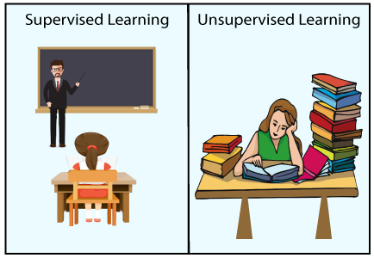
Artificial Intelligence with ML
Machine Learning: Un-Supervised & Semi-Supervised
Introduction to Unsupervised Learning
Definition and purpose of Unsupervised Learning
Trains models on unlabeled data
Identify patterns without supervision
Uncover the underlying structure of data, group it by similarities
Often used for exploratory data analysis and preprocessing
Source : https://www.javatpoint.com
Notes:
SME : In introduction to unsupervised learning we can also add what are the tools and libraries.

Slide 5
Machine Learning: Un-Supervised & Semi-Supervised
What is Unsupervised Learning?
Unsupervised learning is a branch of machine learning that deals with unlabeled data. Unlike supervised learning, where the data is labeled with a specific category or outcome, unsupervised learning algorithms are tasked with finding patterns and relationships within the data without any prior knowledge of the data’s meaning. This makes unsupervised learning a powerful tool for exploratory data analysis, where the goal is to understand the underlying structure of the data.
In artificial intelligence, machine learning that takes place in the absence of human supervision is known as unsupervised machine learning.
Unsupervised machine learning models, in contrast to supervised learning, are given unlabeled data and allow discover patterns and insights on their own—without explicit direction or instruction.

Slide 6
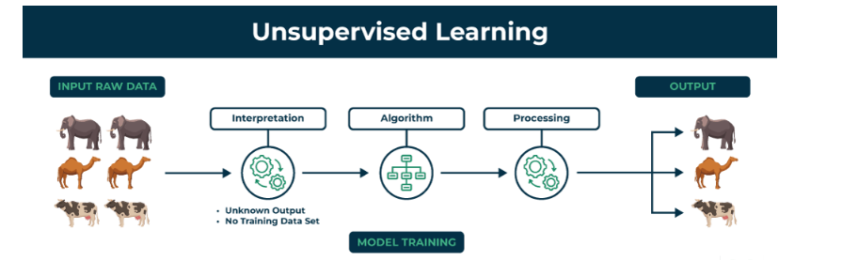
Unsupervised machine learning analyzes and clusters unlabeled datasets using machine learning algorithms. These algorithms find hidden patterns and data without any human intervention, i.e., we don’t give output to our model. The training model has only input parameter values and discovers the groups or patterns on its own.

Slide 7
Why Unsupervised Learning?
A typical workflow in a machine learning project is designed in a supervised manner. We tell the algorithm what to do and what not to do. This generally gives a structure for solving a problem, but it limits the potential of that algorithm in two ways:
It is bound by the biases in which it is being supervised in. Of course it learns how to perform that task on its own. But it is prohibited to think of other corner cases that could occur when solving the problem.
As the learning is supervised – there is a huge manual effort involved in creating the labels for our algorithm. So fewer the manual labels you create, less is the training that you can perform for your algorithm.
To solve this issue in an intelligent way, we can use unsupervised learning algorithms. These algorithms derive insights directly from the data itself, and work as summarizing the data or grouping it, so that we can use these insights to make data driven decisions.

Slide 8
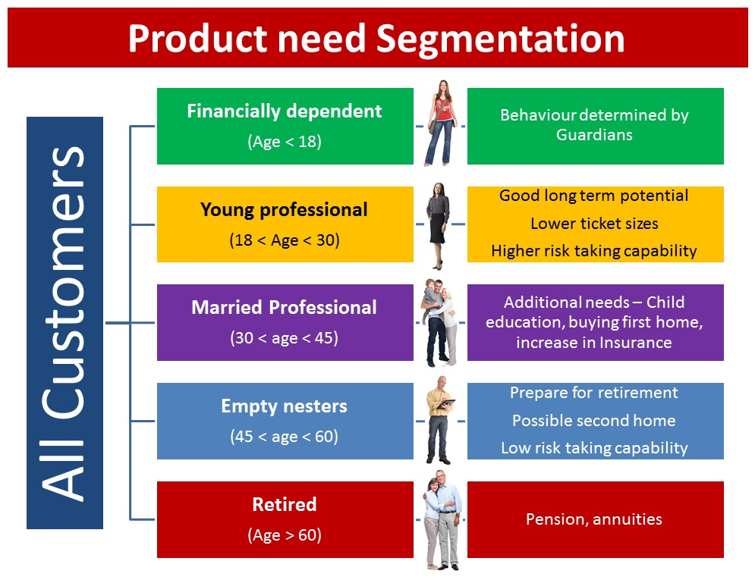
Let’s take an example to better understand this concept. Let’s say a bank wants to divide its customers so that they can recommend the right products to them. They can do this in a data-driven way – by segmenting the customers on the basis of their ages and then deriving insights from these segments. This would help the bank give better product recommendations to their customers, thus increasing customer satisfaction.

Slide 9
How does unsupervised learning work?
Unsupervised learning works by analyzing unlabeled data to identify patterns and relationships. The data is not labeled with any predefined categories or outcomes, so the algorithm must find these patterns and relationships on its own. This can be a challenging task, but it can also be very rewarding, as it can reveal insights into the data that would not be apparent from a labeled dataset.

Slide 10
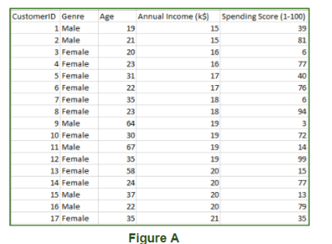
Data-set in Figure A is Mall data that contains information about its clients that subscribe to them. Once subscribed they are provided a membership card and the mall has complete information about the customer and his/her every purchase. Now using this data and unsupervised learning techniques, the mall can easily group clients based on the parameters we are feeding in.

Slide 11
The input to the unsupervised learning models is as follows:
Unstructured data: May contain noisy(meaningless) data, missing values, or unknown data
Unlabeled data: Data only contains a value for input parameters, there is no targeted value(output). It is easy to collect as compared to the labeled one in the Supervised approach.

Slide 12
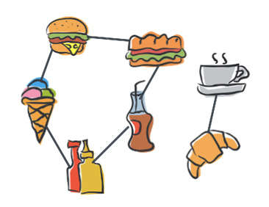
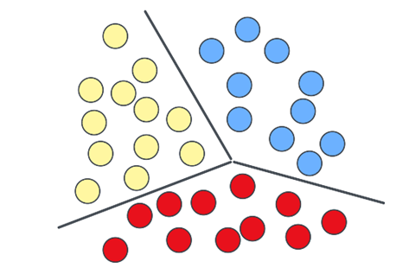
Artificial Intelligence with ML
Machine Learning: Un-Supervised & Semi-Supervised
Introduction to Unsupervised Learning
Different types of Unsupervised Learning algorithms
Unsupervised Learning
Association
Clustering
Notes:
Association Rule
An association rule is a type of unsupervised learning technique used to discover relationships among variables in a large database. It identifies groups of items that frequently appear together in the dataset.
Clustering Clustering is a process that groups objects into clusters based on their similarities. Objects in the same group have high similarity and are dissimilar to objects in other groups. Cluster analysis identifies similarities between data objects and classifies them according to the presence or absence of these similarities.

Slide 13
Artificial Intelligence with ML
Machine Learning: Un-Supervised & Semi-Supervised
Introduction to Unsupervised Learning
Applications of Unsupervised Learning
Customer Segmentation
1
Anomaly Detection
4
Marketing strategies, personalized advertising, and recommendation systems
Fraud detection in finance, network security, and fault detection in manufacturing.
Market Basket Analysis
2
5
Dimensionality Reduction
Cross-selling, upselling, and inventory management.
Data compression, noise reduction, and visualization..
Image Segmentation
3
Document Clustering
6
Medical imaging, autonomous vehicles, and object recognition.
Topic modeling, information retrieval, and recommendation systems
Notes:
SME Notes : Can add Challenges of unsupervised learning.
And also add real world application

Slide 14
Artificial Intelligence with ML
Machine Learning: Un-Supervised & Semi-Supervised
Introduction to Clustering Algorithms
Definition and Importance of Clustering Algorithms
Machine learning techniques used to group a set of objects such that objects in the same group (cluster) are more like each other than to those in other groups.
Key Concept:
Intra-cluster similarity: High
Inter-cluster similarity: Low
Low intra cluster distance
High inter cluster distance

Slide 15
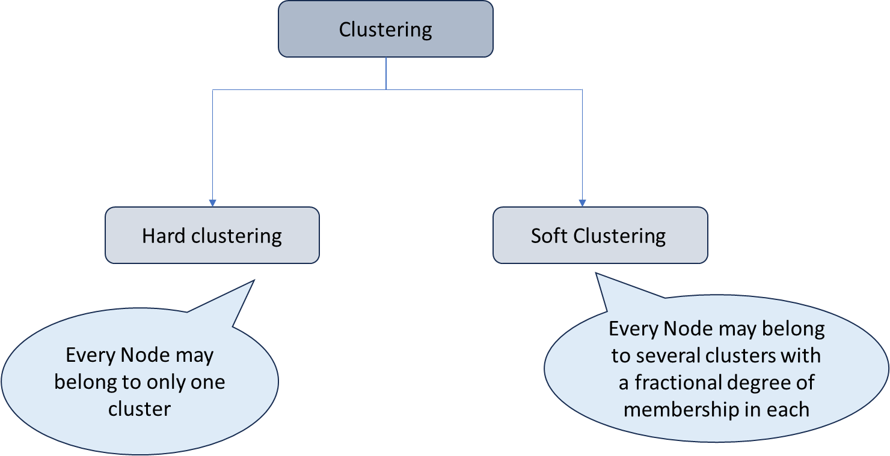
Artificial Intelligence with ML
Machine Learning: Un-Supervised & Semi-Supervised
Introduction to Clustering Algorithms
Types of Clustering
Example: K-Means Clustering
Example: GMM Clustering
Notes:
Hard Clustering Also referred to as crisp clustering, hard clustering is a method where each data point is strictly assigned to a single cluster. There is no overlap between clusters, and each data point is a member of only one cluster.
In the K-Means algorithm, each data point is allocated to the cluster whose mean is the closest. Once a point is assigned to a cluster, it does not belong to any other cluster.
Soft Clustering Soft clustering, also known as fuzzy clustering, is a more flexible method that allows each data point to be part of multiple clusters, each with varying degrees of membership. This method acknowledges the potential for overlaps between clusters.
In the Gaussian Mixture Model (GMM), each data point is assigned a probability of belonging to each cluster, based on Gaussian distributions. Therefore, a point can be part of multiple clusters, each with different probabilities of membership.

Slide 16
Artificial Intelligence with ML
Machine Learning: Un-Supervised & Semi-Supervised
Introduction to Clustering Algorithms
Types of Clustering
Hard clustering
Soft Clustering
2
3
1
4
2
3
6
5
1
4
7
6
5
7
Community Affiliation
Cluster | Nodes
 | 1 | 2 | 3 | 4 | 5 | 6 | 7
Cluster1 | 1 | 1 | 1 | 0 | 0 | 0 | 0
Cluster2 | 0 | 0 | 0 | 1 | 1 | 0 | 0
Cluster3 | 0 | 0 | 0 | 0 | 0 | 1 | 1
Community Affiliation
Cluster | Nodes
 | 1 | 2 | 3 | 4 | 5 | 6 | 7
Cluster1 | 1 | 1 | 1 | 0 | 0 | 0 | 0
Cluster2 | 0 | 0 | 0 | 1 | 1 | 1 | 0
Cluster3 | 0 | 0 | 1 | 0 | 0 | 1 | 1
Notes:
An example of hard and soft clustering in a toy example containing 7 nodes. A. Hard clustering: A node can only belong to one cluster. The table tabulates the community assignment to every node. B. Soft clustering: Five out of seven nodes are clustered in a single cluster/community {nodes 1,2,3,4,6} while nodes {5 and 7} belong to two communities : node 5 belongs to communities 1 and 3 while node 7 belongs to communities 2 and 3. The table tabulates the community assignment to every node.

Slide 17
Artificial Intelligence with ML
Machine Learning: Un-Supervised & Semi-Supervised
Introduction to Clustering Algorithms
Definition and Importance of Clustering Algorithms
Clustering Methods
Partitioning Clustering
K-means clustering
Density-Based Clustering
DBSCAN (Density-Based Spatial Clustering of Applications with Noise)
Notes:
can also add Key differences between clustering and other machine learning tasks like classification and regression.

Slide 18
Artificial Intelligence with ML
Machine Learning: Un-Supervised & Semi-Supervised
Clustering Introduction to Clustering Algorithms
Definition and Importance of Clustering Algorithms
Clustering Methods
Model-Based Clustering
Gaussian Mixture Models (GMM)
Bayesian Clustering
Hierarchical Clustering
Agglomerative Clustering
Notes:
Can add importance and applications of clustering in various fields.

Slide 19
Artificial Intelligence with ML
Machine Learning: Un-Supervised & Semi-Supervised
Introduction to Clustering Algorithms
Applications of Clustering Algorithms in machine learning
Marketing Applications
Healthcare Applications
Targeted Advertising
Customer Behavior Analysis
Patient Segmentation
Disease Outbreak Detection
Finance Applications
Fraud Detection
Customer Segmentation
Social network analysis
Image and Signal Processing
Community Detection
Trend Analysis
Image Segmentation
Signal Segmentation

Slide 20
Artificial Intelligence with ML
Machine Learning: Un-Supervised & Semi-Supervised
Introduction to Clustering Algorithms
Challenges of Clustering Algorithms in machine learning
Choosing the Right Number of Clusters
Handling High-Dimensional Data
Sensitivity to Initialization
Scalability
Handling Non-linear and Non-convex Clusters
Dealing with Noise and Outliers
Interpretability and Evaluation
Handling Categorical and Mixed Data Types

Slide 21
Artificial Intelligence with ML
Machine Learning: Un-Supervised & Semi-Supervised
Introduction to Clustering Algorithms
Challenges and limitations of Clustering Algorithms in machine learning
Choosing the Right Number of Clusters
Handling High-Dimensional Data
Sensitivity to Initialization
Scalability
Handling Non-linear and Non-convex Clusters
Dealing with Noise and Outliers
Interpretability and Evaluation
Handling Categorical and Mixed Data Types

Slide 22
Artificial Intelligence with ML
Machine Learning: Un-Supervised & Semi-Supervised
K-Means Clustering
Introduction to K-Means Clustering
It is an iterative algorithm that divides the unlabeled dataset into k different clusters in such a way that each dataset belongs only one group that has similar properties.
Main tasks
Determines the best value for K center points or centroids by an iterative process.
Assigns each data point to its closest k-center. Those data points which are near to the particular k-center, create a cluster.
Notes:
we can also add Hierarchical clustering vs. K-means.

Slide 23
K-Means Clustering is an Unsupervised Learning algorithm, which groups the unlabeled dataset into different clusters. Here K defines the number of pre-defined clusters that need to be created in the process, as if K=2, there will be two clusters, and for K=3, there will be three clusters, and so on.
It is an iterative algorithm that divides the unlabeled dataset into k different clusters in such a way that each dataset belongs only one group that has similar properties.
It allows us to cluster the data into different groups and a convenient way to discover the categories of groups in the unlabeled dataset on its own without the need for any training.
It is a centroid-based algorithm, where each cluster is associated with a centroid. The main aim of this algorithm is to minimize the sum of distances between the data point and their corresponding clusters.

Slide 24
The algorithm takes the unlabeled dataset as input, divides the dataset into k-number of clusters, and repeats the process until it does not find the best clusters. The value of k should be predetermined in this algorithm.
The k-means clustering algorithm mainly performs two tasks:
Determines the best value for K center points or centroids by an iterative process.
Assigns each data point to its closest k-center. Those data points which are near to the particular k-center, create a cluster.
Hence each cluster has datapoints with some commonalities, and it is away from other clusters.

Slide 25
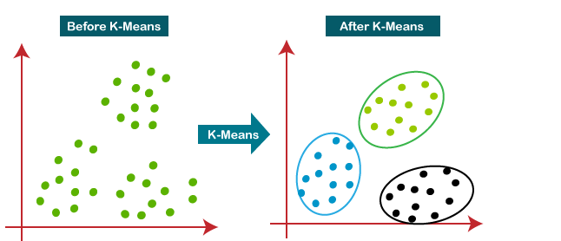

Slide 26
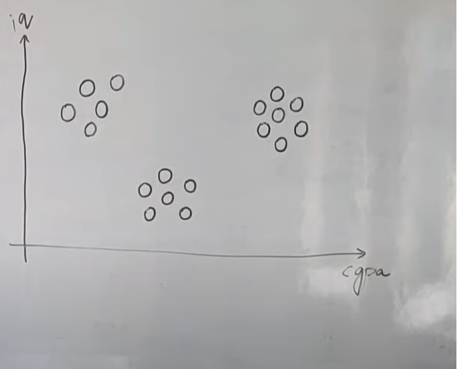
Artificial Intelligence with ML
Machine Learning: Un-Supervised & Semi-Supervised
K-Means Clustering
Introduction to K-Means Clustering
K-Means Algorithm Working
Select the number K to decide the number of clusters.(this is our work to decide)
Notes:
we can add the advance concepts like for choosing the number of clusters Elbow method..

Slide 27
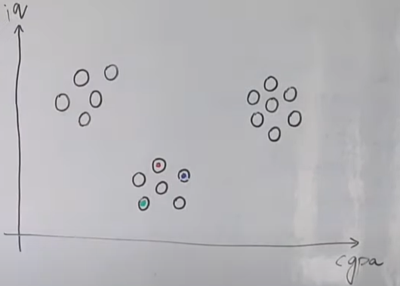
Select random K points or centroids. (It can be other from the input dataset).

Slide 28
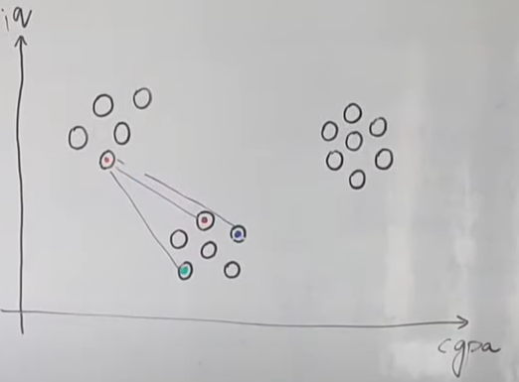
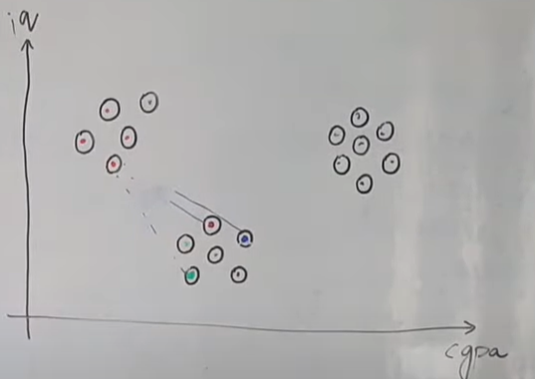
Assign each data point to their closest centroid, form the predefined K clusters.
That means all data points should be assign one cluster on the basis of centroid using Euclidean distance.
We will measure distance of each datapoint from all the three centroids and wherever distance is minimum will assign that data point to same cluster.

Slide 29
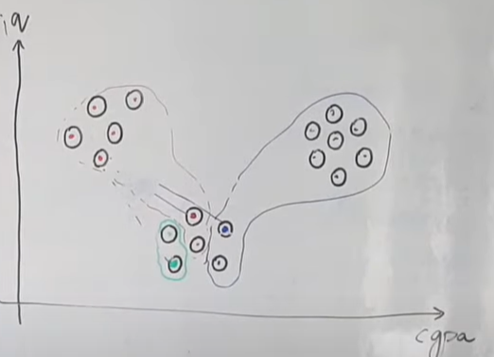
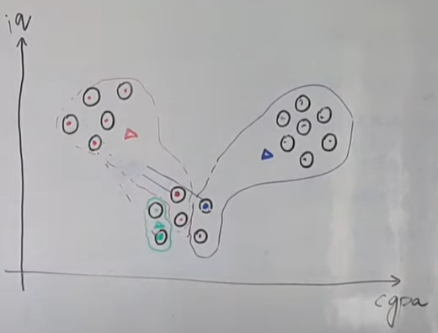
So basically we have created clusters. Now we will calculate new centroids. We know centroid is at the center of any cluster.
So suppose if we want to find out centroid of blue cluster ,then we will calculate cgpa mean and IQ mean of all blue data points, that will be our centroid
Same we will repeat for red and green as well
Calculate the variance and place a new centroid of each cluster

Slide 30
Repeat the third steps, reassign each datapoint to the nearest new centroid
If any reassignment occurs, then go to step-4 else go to FINISH.
The model is ready

Slide 31
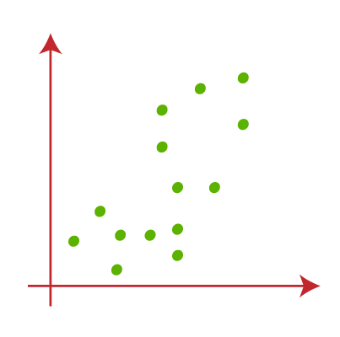
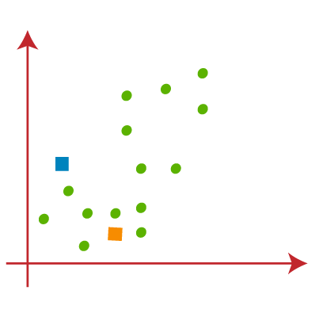
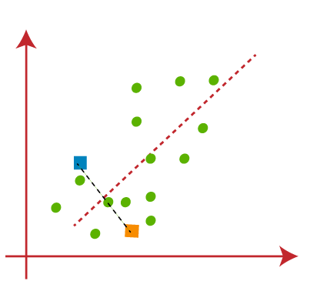
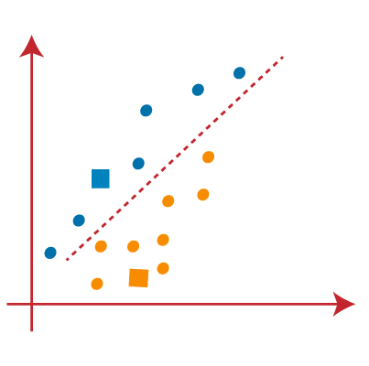
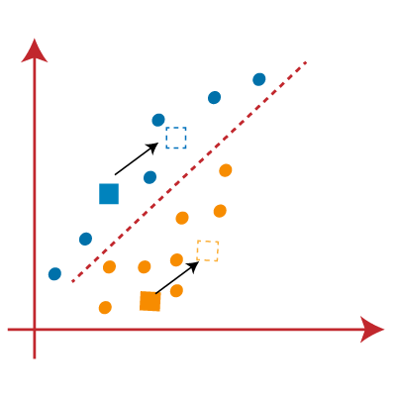
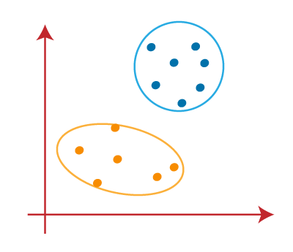
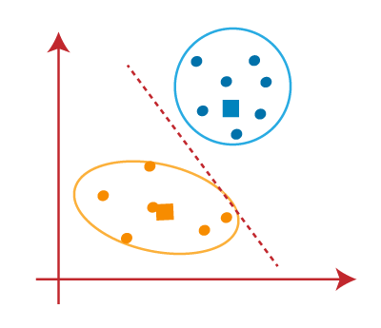
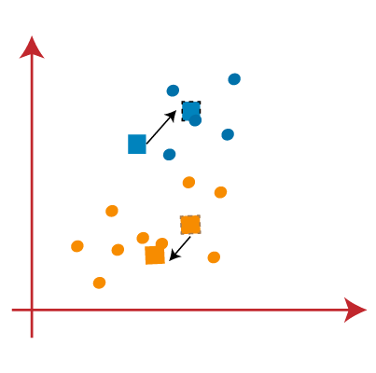
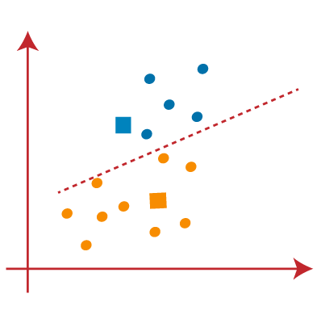
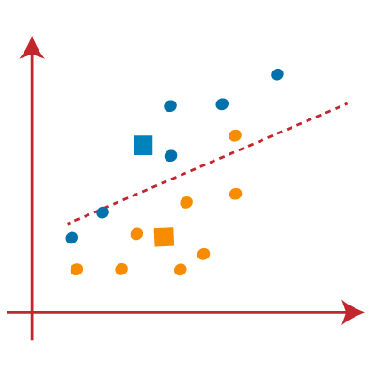
Artificial Intelligence with ML
Machine Learning: Un-Supervised & Semi-Supervised
K-Means Clustering
Introduction to K-Means Clustering
K-Means Algorithm Working
Fig 1
Fig 2
Fig 3
Fig 4
Fig 5
Fig 10
Fig 9
Fig 8
Fig 7
Fig 6
Notes:
Suppose we have two variables, M1 and M2. The scatter plot of these two variables is shown in Fig 1 on the x-y axis.
We decide to use k clusters, specifically K=2, to categorize the dataset into different groups.
This means we will attempt to divide the dataset into two distinct clusters.
We start by selecting some random k points, or centroids, which can either be data points from the dataset or other points entirely.
In this instance, we choose two points that are not part of the dataset, as shown in Fig 2. Next, we assign each data point from the scatter plot to the nearest centroid. This is done by calculating the distance between points, a concept we are familiar with.
We draw a median line between the two centroids, as illustrated in Fig 3.
From this image, it's clear that points to the left of the line are closer to the K1 (blue) centroid, while points to the right are nearer to the yellow centroid. For visualization, we color the points accordingly in Fig 4.
To refine our clusters, we repeat the process by selecting new centroids. These new centroids are determined by computing the center of gravity of the points in each cluster, as shown in Fig 5.
We then reassign each data point to the closest new centroid, repeating the median line process, resulting in Fig 6.
In this new image, we observe that one yellow point is now on the left side of the line, and two blue points are on the right. These three points are reassigned to their new centroids, as depicted in Fig 7.
Since reassignment has occurred, we repeat the process of finding new centroids (K-points) by calculating the center of gravity again, resulting in new centroids shown in Fig 8.
With these new centroids, we draw another median line and reassign the data points, resulting in the image shown in Fig 9. In Fig 9, there are no misassigned data points on either side of the line, indicating that our model is finalized. Refer to Fig 10 for the completed model.

Slide 32
Artificial Intelligence with ML
Machine Learning: Un-Supervised & Semi-Supervised
K-Means Clustering
Advantages of K-Means Clustering
Simplicity and Ease of Implementation
Computational Efficiency
Scalability
Adaptability to Different Data Types
Convergence and Deterministic Nature
Interpretability
Versatility in Applications
Notes:
K-Means is simple to understand and implement.
It is computationally efficient, making it suitable for large datasets.
It scales well with the size of the dataset.
It can be adapted to handle different types of data, such as continuous and categorical.
It typically finds a solution quickly, demonstrating fast convergence.
The results from K-Means clustering are straightforward and easy to interpret.
It is a versatile algorithm, widely used across various fields.

Slide 33
Artificial Intelligence with ML
Machine Learning: Un-Supervised & Semi-Supervised
K-Means Clustering
Limitations of K-Means Clustering
Need to Specify Number of Clusters
Sensitivity to Initial Centroids
Assumption of Spherical Clusters
Sensitivity to Outliers and Noise
Scalability Issues with Large Datasets
Handling High-Dimensional Data
Dependence on Euclidean Distance
Notes:
K-Means necessitates the pre-specification of the number of clusters (denoted as K).
The algorithm’s effectiveness is heavily influenced by the initial positioning of centroids. Inadequate initialization can result in less than ideal clusters and settling at local minima. To find an optimal solution, it might be necessary to run the algorithm multiple times with different starting points.
K-Means operates under the assumption that clusters are spherical and of uniform size. This makes it unsuitable for clusters that are irregularly shaped or vary in size and density. It may not accurately represent complex cluster structures.
K-Means is susceptible to outliers and noise in the data. Outliers can cause significant distortions in the clustering results, while noise can lead to incorrect placement of centroids and cluster assignments.
K-Means may face difficulties when dealing with very large datasets. As the number of data points increases, so does the computational complexity. This could necessitate significant memory and processing power for big data applications.
K-Means can have issues with high-dimensional data due to the “curse of dimensionality.” Distance metrics become less effective in high dimensions. Techniques to reduce dimensionality may be required, which could result in the loss of important information.
K-Means is dependent on Euclidean distance, which may not be appropriate for all types of data.

Slide 34
Why the Spherical Cluster Assumption Matters:Cluster Assignment: K-means assigns each data point to the nearest cluster centroid. If clusters are spherical, this assignment makes intuitive sense because points near a centroid are closer in Euclidean distance than points far away. In practice, this means that clusters will be separated neatly along circular or spherical boundaries.Convergence: K-means works by iteratively updating the centroids and assigning points to the closest centroid. The spherical cluster assumption ensures that K-means converges to a solution where centroids are near the center of clusters with roughly circular shapes

Slide 35
Different Evaluation Metrics for Clustering
When it comes to evaluating how well your clustering algorithm is working, there are a few key metrics that can help you get a clearer picture of your results. Here’s a rundown of the most useful ones:
Silhouette Analysis
Silhouette analysis is like a report card for your clusters. It measures how well each data point fits into its own cluster compared to other clusters. A high silhouette score means that your points are snugly fitting into their clusters and are quite distinct from points in other clusters. Imagine a score close to 1 as a sign that your clusters are well-defined and separated. Conversely, a score close to 0 indicates some overlap, and a negative score suggests that the clustering might need some work.
Inertia
Inertia is a bit like a gauge of how tightly packed your data points are within each cluster. It calculates the sum of squared distances from each point to the cluster's center (or centroid). Think of it as measuring how snugly the points are huddled together. Lower inertia means that points are closer to the centroid and to each other, which generally indicates that your clusters are well-formed

Slide 36
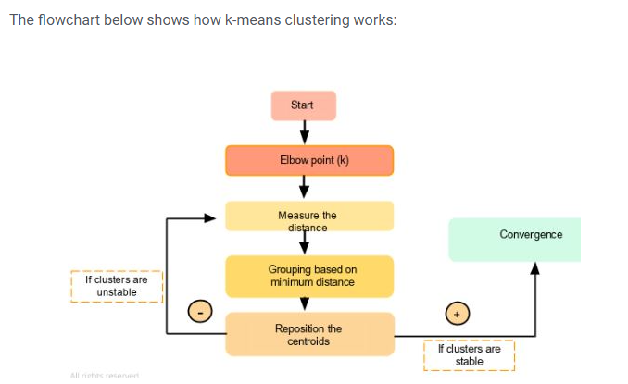
The goal of the K-Means algorithm is to find clusters in the given input data. There are a couple of ways to accomplish this. We can use the trial and error method by specifying the value of K (e.g., 3,4, 5). As we progress, we keep changing the value until we get the best clusters
Another method is to use the Elbow technique to determine the value of K.
Once we get the K's value, the system will assign that many centroids randomly and measure the distance of each of the data points from these centroids. Accordingly, it assigns those points to the corresponding centroid from which the distance is minimum. So each data point will be assigned to the centroid, which is closest to it. Thereby we have a K number of initial clusters.
It calculates the new centroid position for the newly formed clusters. The centroid's position moves compared to the randomly allocated one.
Once again, the distance of each point is measured from this new centroid point. If required, the data points are relocated to the new centroids, and the mean position or the new centroid is calculated once again.
If the centroid moves, the iteration continues indicating no convergence. But once the centroid stops moving (which means that the clustering process has converged), it will reflect the result.
How Does K-Means Clustering Work?

Slide 37
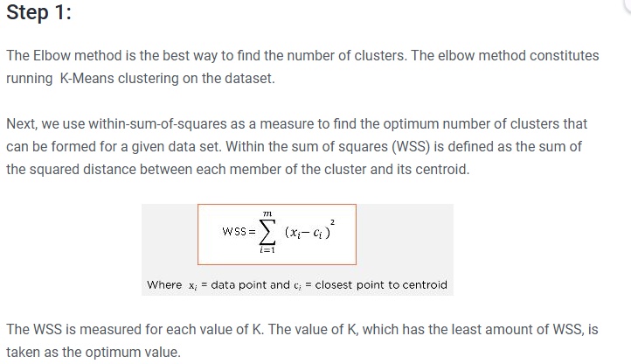
We have a data set for a grocery shop, and we want to find out how many clusters this has to be spread across. To find the optimum number of clusters, we break it down into the following steps:

Slide 38
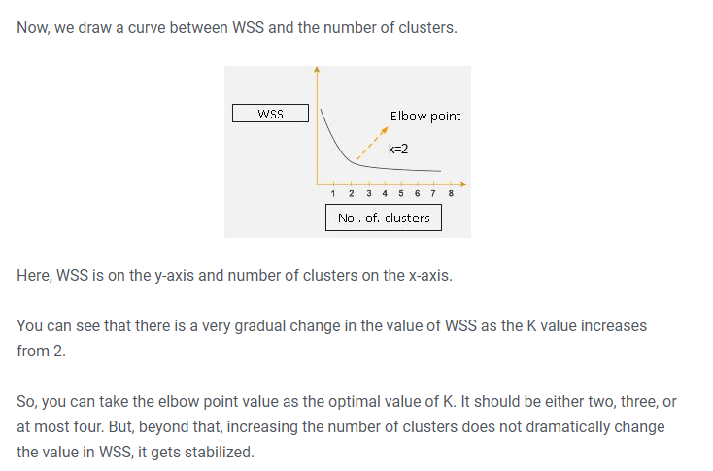

Slide 39
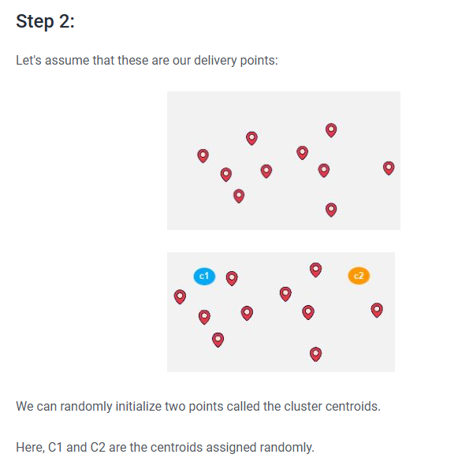

Slide 40
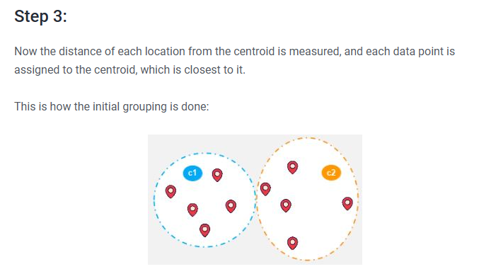

Slide 41
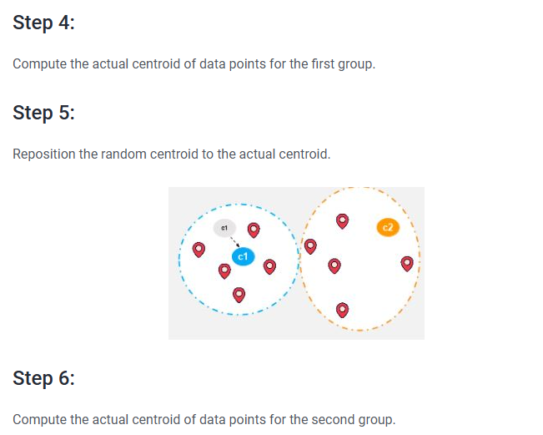

Slide 42
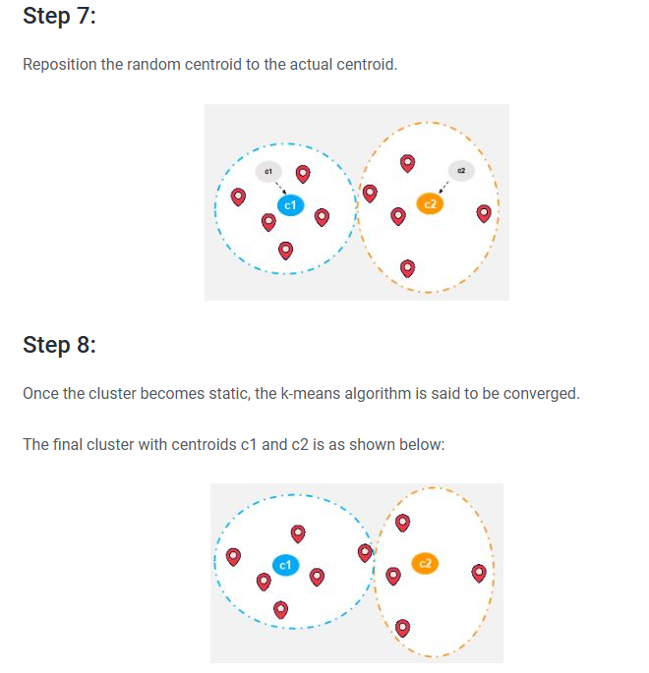

Slide 43
Artificial Intelligence with ML
Machine Learning: Un-Supervised & Semi-Supervised
K-Means Clustering
Lab: Implement K-Means Clustering on ABC dataset
Problem Statement:
A mall wants to better understand its customer base and tailor its marketing strategies to different customer segments. use the K-means clustering algorithm to segment its customers into distinct groups based on their characteristics and spending behavior.
Objective:
To utilize the K-means clustering algorithm to segment the customer base of a mall into distinct groups based on their demographic characteristics and spending behavior based on “Mall_Customers.csv”.
Notes:
Dataset: https://www.kaggle.com/code/heeraldedhia/kmeans-clustering-for-customer-data

Slide 44
Machine Learning: Un-Supervised & Semi-Supervised
K-Means Clustering
Lab: Implement K-Means Clustering on ABC dataset
Steps:
Data Collection and Exploration
Load the dataset and identify the key features and target variable.
Data Preprocessing
Clean and prepare the data for modeling.
Handle missing values
Encode categorical variables
Normalize numerical features
Feature Engineering
Create additional features to improve the predictive power of the model.

Slide 45
Machine Learning: Un-Supervised & Semi-Supervised
K-Means Clustering
Lab: Implement K-Means Clustering on ABC dataset
Steps:
Implementing K-Means Clustering
from sklearn.cluster import KMeans
algorithm = (KMeans(n_clusters = 4 ,init='k-means++', n_init = 10 ,max_iter=300,
tol=0.0001, random_state= 111 , algorithm='elkan’) )
algorithm.fit(X1)
labels1 = algorithm.labels_
centroids1 = algorithm.cluster_centers_

Slide 46
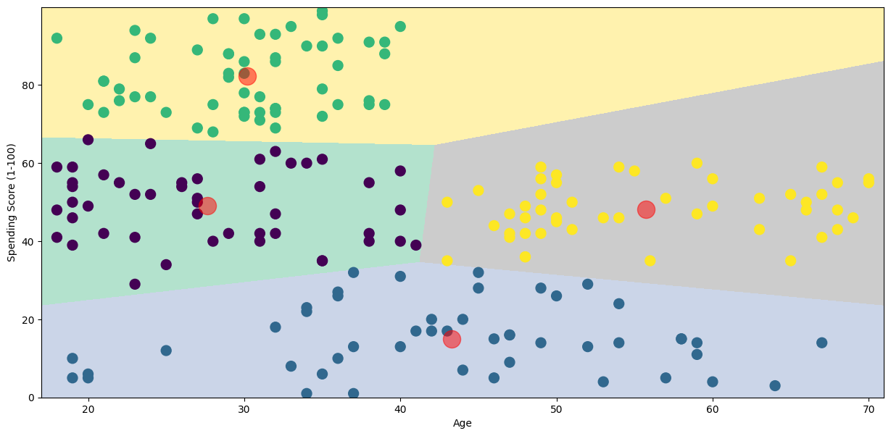
Machine Learning: Un-Supervised & Semi-Supervised
K-Means Clustering
Lab: Implement K-Means Clustering on ABC dataset
Steps:
Model Evaluation
Assess the performance of the K-Means model using appropriate metrics such as silhouette score, inertia, or Davies–Bouldin index.

Slide 47
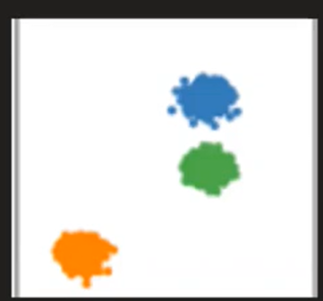
Problem with k mean clustering
K means works on distance,we calculate distance to centroid
If this kind of data,then kmeans work properly

Slide 48
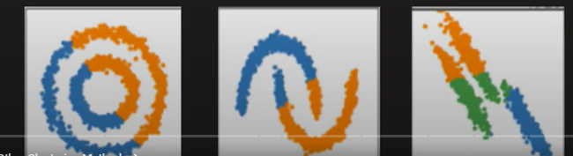

Slide 49
Artificial Intelligence with ML
Machine Learning: Un-Supervised & Semi-Supervised
Hierarchical Clustering
Introduction to Hierarchical Clustering
Hierarchical clustering is a method of cluster analysis which seeks to build a hierarchy of clusters.
1,2,3,4,5
Root
1,2
4,5
Node
1
2
3
4
5
Leaf
Notes:
can add Understand how clusters can be updated dynamically as new data points arrive.

Slide 50
Artificial Intelligence with ML
Machine Learning: Un-Supervised & Semi-Supervised
Hierarchical Clustering
Introduction to Hierarchical Clustering
Types of Hierarchical Clustering
Agglomerative
Each data point starts as its own cluster.
At each step, the two closest clusters are merged based on a similarity measure.
This process continues until all points belong to a single cluster.
Divisive
All data points initially belong to a single cluster.
At each step, the cluster is split into smaller clusters until each cluster contains only one data point.

Slide 51
Artificial Intelligence with ML
Machine Learning: Un-Supervised & Semi-Supervised
Hierarchical Clustering
Introduction to Hierarchical Clustering
Types of Hierarchical Clustering
Agglomerative Method
Notes:
Agglomerative clustering begins with every data point forming an individual cluster. It then progressively combines the nearest clusters in an iterative process until only a single cluster is left or a predetermined number of clusters has been achieved. This method adopts a bottom-up strategy, constructing a hierarchical structure of clusters that is visualized using a dendrogram

Slide 52
Artificial Intelligence with ML
Machine Learning: Un-Supervised & Semi-Supervised
Hierarchical Clustering
Introduction to Hierarchical Clustering
Agglomerative Hierarchical clustering Algorithm steps
Compute the proximity matrix using a distance metric.
Use a linkage function to group objects into a hierarchical cluster tree based on the computed distance matrix from the above step.
Data points with close proximity are merged together to form a cluster.
Repeat steps 2 and 3 until a single cluster remains.

Slide 53
Artificial Intelligence with ML
Machine Learning: Un-Supervised & Semi-Supervised
Hierarchical Clustering
Introduction to Hierarchical Clustering
Agglomerative Hierarchical clustering Algorithm steps
Step 0
Step 1
Step 2
Step 3
Step 4
a
b
b,c
c
Hierarchical tree - dendrogram.
b,c,d,e,f
a,b,c,d,e,f
d
d,e
d,e,f
e
f
Bottom-up Approach
Notes:
The data points a,b,c…f are assigned to each individual cluster.
After calculating the proximity matrix, based on the similarity the points b,c and d,e are merged together to form clusters.
Again, the proximity matrix is computed and clusters with points d,e and f are merged together.
And again, the proximity matrix is computed, then the clusters with points d,e,f and b,c are merged together to form a cluster.
As a final step, the remaining clusters are merged together to form a single cluster.

Slide 54
Steps:
Consider each alphabet as a single cluster and calculate the distance of one cluster from all the other clusters.
In the second step, comparable clusters are merged together to form a single cluster. Let’s say cluster (B) and cluster (C) are very similar to each other therefore we merge them in the second step similarly to cluster (D) and (E) and at last, we get the clusters [(A), (BC), (DE), (F)]
We recalculate the proximity according to the algorithm and merge the two nearest clusters([(DE), (F)]) together to form new clusters as [(A), (BC), (DEF)]
Repeating the same process; The clusters DEF and BC are comparable and merged together to form a new cluster. We’re now left with clusters [(A), (BCDEF)].
At last, the two remaining clusters are merged together to form a single cluster [(ABCDEF)].

Slide 55
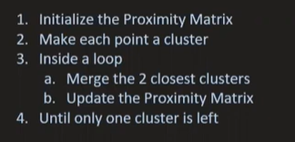
Algorithm

Slide 56
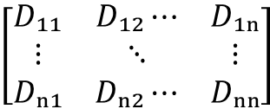
Artificial Intelligence with ML
Machine Learning: Un-Supervised & Semi-Supervised
Agglomerative Hierarchical clustering
Proximity Matrix and Linkage
The proximity matrix is a matrix consisting of the distance between each pair of data points. The distance is computed by a distance function.
Euclidean distance is one of the most commonly used distance functions.
The general form of a proximity matrix is a symmetric square matrix
𝐷ₘₙ represents the proximity measure between object ‘m’ and object ’n’.
$$\left[\begin{matrix}D₁₁ & D₁₂⋯ & D₁ₙ \\ ⋮ & ⋱ & ⋮ \\ Dₙ₁ & Dₙ₂⋯ & Dₙₙ\end{matrix}\right]$$

Slide 57
Lets say there are 5 points then matrix will be
P1 P2 P3 P4 P5
P1 0 . . . .
P2 . 0 . . .
P3 . . 0 . .
P4 . . . 0 .
P5 . . . . 0
Now if p3 and p4 are close then wemake them acluster called c1

Slide 58
So new matrix will be
P1 P2 C1 P5
P1 0 . ? .
P2 . 0 ? .
C1 ? ? 0 .
P5 . . . 0
And so on until single cluster is formed

Slide 59
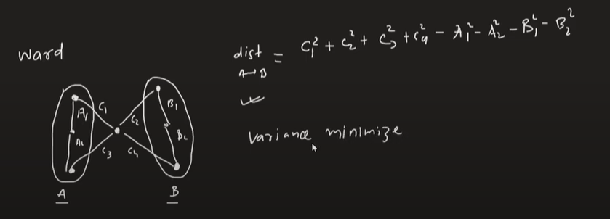
Computing Distance Matrix
While merging two clusters we check the distance between two every pair of clusters and merge the pair with the least distance/most similarity. But the question is how is that distance determined. There are different ways of defining Inter Cluster distance/similarity. Some of them are:
Min Distance: Find the minimum distance between any two points of the cluster.
Max Distance: Find the maximum distance between any two points of the cluster.
Group Average: Find the average distance between every two points of the clusters.
Ward’s Method: The similarity of two clusters is based on the increase in squared error when two clusters are merged.(default in scikitlearn

Slide 60
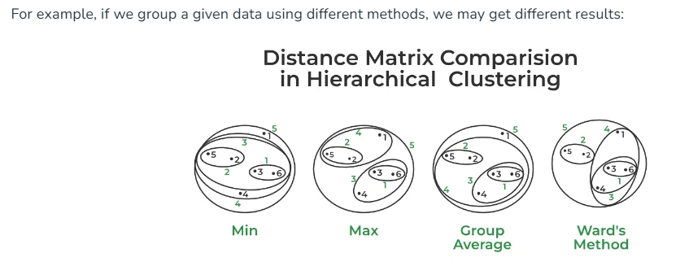

Slide 61
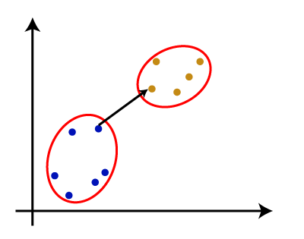
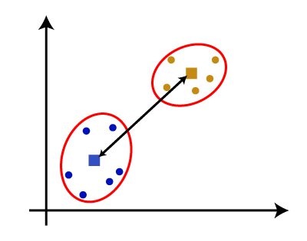
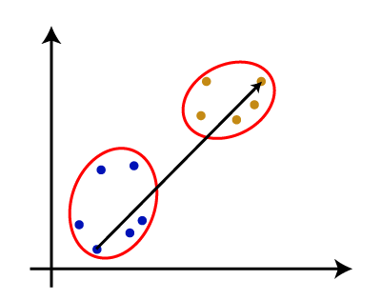
Artificial Intelligence with ML
Machine Learning: Un-Supervised & Semi-Supervised
Hierarchical Clustering
Introduction to Hierarchical Clustering
Agglomerative Hierarchical clustering
Common linkage methods
Maximum or Complete linkage
Minimum or Single linkage
Centroid linkage
Mean or Average linkage: The average of all pairwise distances between elements in each pair of clusters is used to measure the distance between two clusters.
Single linkage:
Centroid linkage
Complete linkage
Notes:
Complete Linkage: This method uses the greatest distance between elements in each pair of clusters to calculate the distance between two clusters.
Single Linkage: This approach measures the distance between clusters based on the shortest distance between the nearest points of the clusters.

Slide 62
Single Linkage (Min Distance) is suitable for detecting elongated or chain-like clusters but is sensitive to outliers.
Complete Linkage (Max Distance) ensures compact, well-separated clusters but can be overly restrictive.
Average Linkage (Group Average) is a good middle ground, balancing compactness and separation.
Ward's Method is often preferred in practice because it minimizes within-cluster variance and creates balanced, compact clusters.
In scikit-learn, Ward’s method is the default choice for hierarchical clustering because it tends to produce well-balanced and compact clusters, making it the most robust for many clustering applications. However, the other methods are useful depending on the nature of the data and the desired characteristics of the resulting clusters.

Slide 63
Artificial Intelligence with ML
Machine Learning: Un-Supervised & Semi-Supervised
Hierarchical Clustering
Introduction to Hierarchical Clustering
Agglomerative Hierarchical clustering
Distance Metrics
Euclidean Distance: Straight-line distance between two points in Euclidean space.
Manhattan Distance: Sum of the absolute differences of the coordinates.
Cosine Distance: Based on the cosine of the angle between two vectors.
Minkowski Distance: A generalization of both Euclidean and Manhattan distances.
Euclidean
Manhattan
Cosine
Minkowski

Slide 64
Artificial Intelligence with ML
Machine Learning: Un-Supervised & Semi-Supervised
Hierarchical Clustering
Introduction to Hierarchical Clustering
Types of Hierarchical Clustering
Divisive Method
Notes:
Divisive clustering starts with a single cluster that includes all data points. It then repeatedly divides the cluster into smaller ones until each data point forms its own cluster or until a specified number of clusters is reached. This method employs a top-down strategy, resulting in a hierarchical arrangement of clusters

Slide 65
Artificial Intelligence with ML
Machine Learning: Un-Supervised & Semi-Supervised
Hierarchical Clustering
Introduction to Hierarchical Clustering
Types of Hierarchical Clustering
Aspect | Agglomerative Clustering | Divisive Clustering
Methodology | Bottom-up approach | Top-down approach
Starting point | Each data point is initially individual cluster | All data points are initially part of one single cluster
Merging process | Based on some similarity measure | Based on some dissimilarity measure
Complexity | Less computationally expensive | More computationally expensive
Scalability | Can handle large datasets efficiently | May struggle with large datasets
Result | Produces a hierarchy of clusters-dendrogram | Results in a flat partitioning of the data into clusters

Slide 66
Artificial Intelligence with ML
Machine Learning: Un-Supervised & Semi-Supervised
Hierarchical Clustering
Advantages of Hierarchical Clustering
No need to specify the number of clusters beforehand
Hierarchical representation
Flexibility in cluster shapes
No sensitivity to initialization
Incorporation of different distance metrics
Interpretability
Merge and split clusters
Notes:
No need to specify the number of clusters beforehand: Hierarchical clustering automatically generates a hierarchy of clusters, allowing flexibility in the number of clusters chosen.
Hierarchical representation: Produces a dendrogram that visually represents the clustering process, aiding in understanding cluster relationships.
Flexibility in cluster shapes: Can handle clusters of various shapes and sizes, making it suitable for complex datasets.
No sensitivity to initialization: Unlike k-means, hierarchical clustering is not sensitive to initial cluster centroids, leading to more consistent results.
Incorporation of different distance metrics: Can utilize various distance measures to accommodate different types of data and domains.
Interpretability: The hierarchical structure allows for easy interpretation, enabling the identification of meaningful subgroups within the data.
Merge and split clusters: Provides the ability to merge or split clusters at different levels of the dendrogram, allowing for exploration of data at various granularities.

Slide 67
Artificial Intelligence with ML
Machine Learning: Un-Supervised & Semi-Supervised
Hierarchical Clustering
Limitations of Hierarchical Clustering
Computationally intensive
Memory requirements
Difficulty in handling noise and outliers
Hierarchical nature may not fit all datasets
Difficulty in dealing with non-globular clusters
Fixed hierarchy once dendrogram is built
Notes:
Computationally intensive: Hierarchical clustering can be computationally expensive, especially for large datasets, as it requires calculating distances between all pairs of data points.
Memory requirements: Building the entire dendrogram structure may require a significant amount of memory, making it impractical for very large datasets.
Difficulty in handling noise and outliers: Hierarchical clustering can be sensitive to noise and outliers, which can affect the structure of the dendrogram and the resulting clusters.
Hierarchical nature may not fit all datasets: The hierarchical nature of clustering may not be suitable for all types of data or analysis tasks, especially when the underlying structure of the data is not hierarchical.
Difficulty in dealing with non-globular clusters: Hierarchical clustering may struggle with identifying non-globular clusters or clusters with complex shapes, as it tends to create spherical or ellipsoidal clusters.
Fixed hierarchy once dendrogram is built: Once the dendrogram is constructed, the hierarchy of clusters is fixed, and it may be challenging to modify or update the clustering without rebuilding the entire structure.

Slide 68
Artificial Intelligence with ML
Machine Learning: Un-Supervised & Semi-Supervised
Hierarchical Clustering
Lab: Implement Hierarchical Clustering on ABC dataset
Problem Statement:
A mall wants to better understand its customer base and tailor its marketing strategies to different customer segments. use the Hierarchical clustering algorithm to segment its customers into distinct groups based on their characteristics and spending behavior.
Objective:
To utilize the Hierarchical means clustering algorithm to segment the customer base of a mall into distinct groups based on their demographic characteristics and spending behavior based on “Mall_Customers.csv”.
Notes:
Dataset: https://www.kaggle.com/code/heeraldedhia/hierarchical-clustering-for-customer-data

Slide 69
Artificial Intelligence with ML
Machine Learning: Un-Supervised & Semi-Supervised
Hierarchical Clustering
Lab: Implement Hierarchical Clustering on ABC dataset
Steps:
Data Collection and Exploration
Load the dataset and identify the key features and target variable.
Data Preprocessing
Clean and prepare the data for modeling.
Handle missing values
Encode categorical variables
Normalize numerical features

Slide 70
Artificial Intelligence with ML
Machine Learning: Un-Supervised & Semi-Supervised
Hierarchical Clustering
Lab: Implement Hierarchical Clustering on ABC dataset
Steps:
Feature Engineering
Create additional features to improve the predictive power of the model.
Implementing Hierarchical Clustering
Apply hierarchical clustering to segment customers based on their purchasing behavior. hc = AgglomerativeClustering(n_clusters = 5, affinity = 'euclidean', linkage ='average’)
y_hc = hc.fit_predict(df)
https://github.com/Priyanshu501/Customer_Segmentation_for_Targeted_Marketing/blob/main/Hierarchial_Clustering.ipynb

Slide 71
Artificial Intelligence with ML
Machine Learning: Un-Supervised & Semi-Supervised
Hierarchical Clustering
Lab: Implement Hierarchical Clustering on ABC dataset
Steps:
Visual Inspection
Use dendrogram to visualize the hierarchy and determine the optimal number of clusters.
plt.figure(1, figsize = (16 ,8))
dendrogram = sch.dendrogram(sch.linkage(df, method = "ward"))
plt.title('Dendrogram')
plt.xlabel('Customers')
plt.ylabel('Euclidean distances')
plt.show()

Slide 72
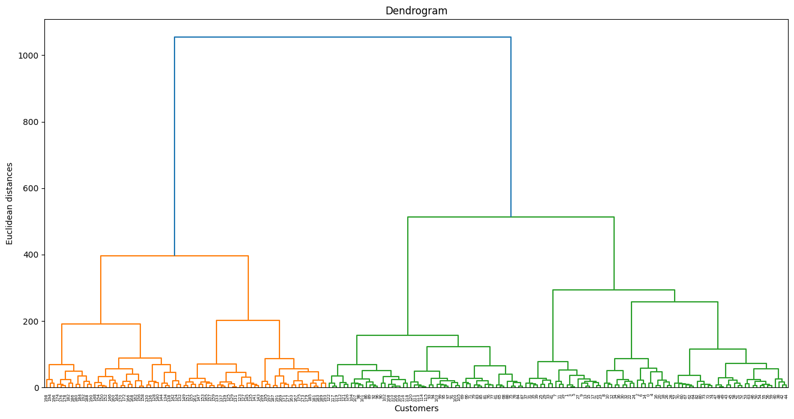
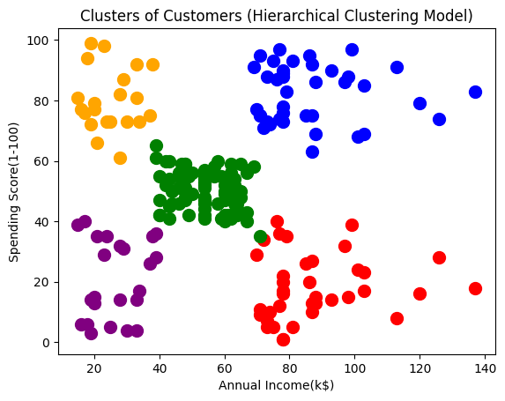
Artificial Intelligence with ML
Machine Learning: Un-Supervised & Semi-Supervised
Hierarchical Clustering
Lab: Implement Hierarchical Clustering on ABC dataset
Output

Slide 73
Artificial Intelligence with ML
Machine Learning: Un-Supervised & Semi-Supervised
Introduction to Association Rules
Definition and their significance
Definition
Association refers to the discovery of interesting relationships or patterns in data. It involves identifying associations between different variables or items in a dataset.
Significance in Unsupervised Learning
It plays a significant role in gaining insights, supporting decision-making, facilitating feature engineering, and detecting anomalies.

Slide 74


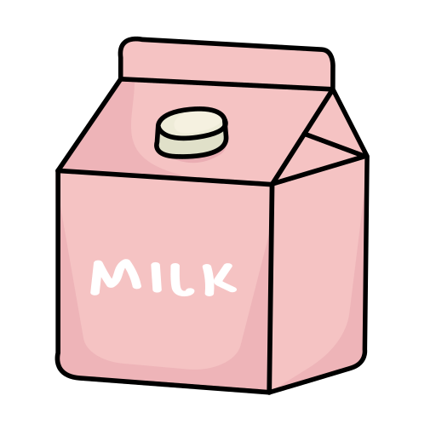


Artificial Intelligence with ML
Machine Learning: Un-Supervised & Semi-Supervised
Introduction to Association Rules
Definition and their significance
Association Rule Mining
A technique used to find relationships, patterns, or associations among a set of items in large datasets.
A rule is a relationship between items in the form of an implication, typically denoted as {𝐴}→{𝐵}
Notes:
Association rules are conditional statements that help to identify the likelihood of relationships between data items within large datasets in various databases. Essentially, association rule mining uses machine learning models to examine data for patterns, or co-occurrences, in a database. It uncovers frequent if-then associations, which are the association rules themselves.
Association rule learning is a crucial concept in machine learning and is used in Market Basket analysis, Web usage mining, continuous production, and more. As their name suggests, association rules discover the relationships or dependencies among the data. Association rule learning operates on the principle of If and Else Statement, such as if A then B. In this context, the If element is referred to as the antecedent, and the Then statement is known as the consequent. Relationships where an association or relation between two items can be found are known as single cardinality. The process is all about creating rules, and as the number of items increases, the cardinality also increases proportionally.
The association rule “bread + milk -> butter” has a high confidence level, indicating that customers who purchase bread and milk together are highly likely to also buy butter

Slide 75
Artificial Intelligence with ML
Machine Learning: Un-Supervised & Semi-Supervised
Introduction to Association Rules
Applications of Association Rules
Market Basket Analysis
Cross-Selling and Upselling
Healthcare Analytics
Web Mining
Fraud Detection
Supply Chain Management
Telecommunications
Text Mining and Natural Language Processing (NLP)
Social Network Analysis
Notes:
Identifying frequently co-occurring items in retail transactions. Helps in understanding customer purchasing behavior and optimizing product placement and marketing strategies
Recommending complementary or related products based on association rules.Improves sales revenue by suggesting additional items to customers.
Analyzing patient records to discover associations between symptoms, diagnoses, and treatments.Facilitates personalized medicine and improves healthcare decision-making.
Analyzing web clickstream data to uncover sequential patterns in user behavior. Enhances website design, content organization, and user experience.
Identifying suspicious patterns or anomalies in financial transactions. Helps in detecting fraudulent activities and reducing financial losses.
Analyzing purchase orders and inventory data to identify supply chain inefficiencies or patterns. Optimizes inventory management, procurement processes, and logistics operations.
Analyzing call detail records to uncover calling patterns and customer behaviors. Improves network planning, resource allocation, and customer segmentation.
Discovering associations between words or phrases in textual data. Enhances sentiment analysis, topic modeling, and recommendation systems.
Identifying communities, influencers, and relationships in social networks. Facilitates targeted marketing, content recommendation, and community engagement.

Slide 76
Artificial Intelligence with ML
Machine Learning: Un-Supervised & Semi-Supervised
Introduction to Association Rules
Association Rule Mining
Basic Metrics
To measure the associations between thousands of data items, there are several metrics. These metrics are given below:
Support
Confidence
Lift

Slide 77
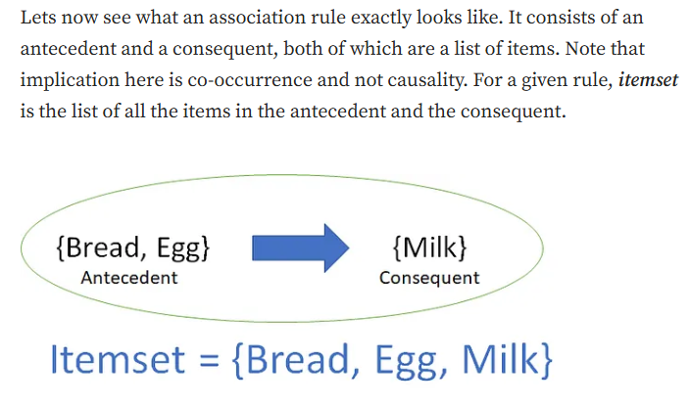

Slide 78
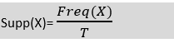
1. Support
This measure gives an idea of how frequent an itemset is in all the transactions.
Consider itemset1 = {bread} and itemset2 = {shampoo}.
There will be far more transactions containing bread than those containing shampoo.
So as you rightly guessed, itemset1 will generally have a higher support than itemset2.
Value of support helps us identify the rules worth considering for further analysis.
For example, one might want to consider only the itemsets which occur at least 50 times out of a total of 10,000 transactions i.e. support = 0.005.
If an itemset happens to have a very low support, we do not have enough information on the relationship between its items and hence no conclusions can be drawn from such a rule.

Slide 79

Confidence
Confidence indicates how often the rule has been found to be true. Or how often the items X and Y occur together in the dataset when the occurrence of X is already given. It is the ratio of the transaction that contains X and Y to the number of records that contain X.

Slide 80
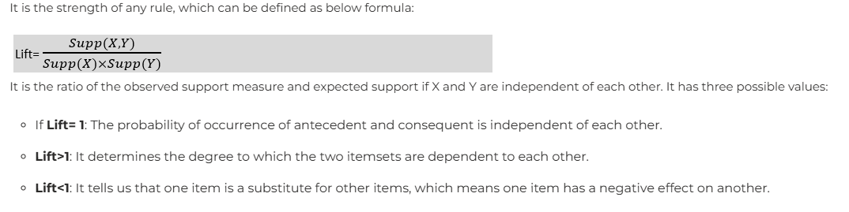
Lift

Slide 81
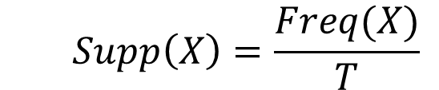
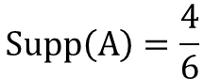
Artificial Intelligence with ML
Machine Learning: Un-Supervised & Semi-Supervised
Introduction to Association Rules
Association Rule Mining
Basic Metrics
Support
Transactions | Item sets
1 | B C D
2 | A C D E F
3 | A B D
4 | B C D
5 | A C D
6 | A B E
Item | Support
A | 4/6
B | 4/6
C | 3/6
D | 5/6
E | 2/6
F | 1/6
$$Supp\left(X\right)=\frac{Freq(X)}{T}$$
$$Supp\left(A\right)=\frac{4}{6}$$
Notes:
Support refers to the occurrence frequency of A or how often an item shows up in the dataset. It’s calculated as the proportion of the transaction T that includes the itemset X. If there are X datasets, then for transactions T, it can be expressed as:
Supp(X)=Freq(X)/T​
”

Slide 82


Artificial Intelligence with ML
Machine Learning: Un-Supervised & Semi-Supervised
Introduction to Association Rules
Association Rule Mining
Basic Metrics
Confidence
Transactions | Item sets
1 | B C D
2 | A C D E F
3 | A B D
4 | B C D
5 | A C D
6 | A B E
$$Confidence=\frac{Freq(X,Y)}{Freq(X)}$$
$$Confidence(A→B)=\frac{Supp(A,B)}{Supp(A)}$$
Notes:
Confidence represents the frequency of the rule being accurate. In other words, it’s the frequency of items X and Y appearing together in the dataset, given the presence of X. It’s calculated as the ratio of transactions that include both X and Y to the number of records that contain X. It can be expressed as:
Confidence=Freq(X)/Freq(X,Y)​

Slide 83


Artificial Intelligence with ML
Machine Learning: Un-Supervised & Semi-Supervised
Introduction to Association Rules
Association Rule Mining
Basic Metrics
Lift
Transactions | Item sets
1 | B C D
2 | A C D E F
3 | A B D
4 | B C D
5 | A C D
6 | A B E
Lift$=\frac{Supp(X,Y)}{Supp(X)×Supp(Y)}$
$$Lift(A→B)=\frac{Supp(A,B)}{Supp(A)×Supp(B)}$$

Slide 84
Artificial Intelligence with ML
Machine Learning: Un-Supervised & Semi-Supervised
Apriori Algorithm
Introduction to Apriori Algorithm
Objective is to create the association rule between different objects.
This algorithm was given by the R. Agrawal and Srikant in the year 1994.
123 124 134 234
12 13 14 23 24 34
1 2 3 4
Notes:
The main goal of the Apriori algorithm is to establish association rules between various items. These association rules illustrate how multiple items are interconnected. The Apriori algorithm is also known as frequent pattern mining.
The Apriori algorithm assumes that any subset of a frequent itemset is also a frequent itemset. This method allows the algorithm to reduce the number of candidate itemsets by only considering those with support counts that exceed the minimum support count.

Slide 85





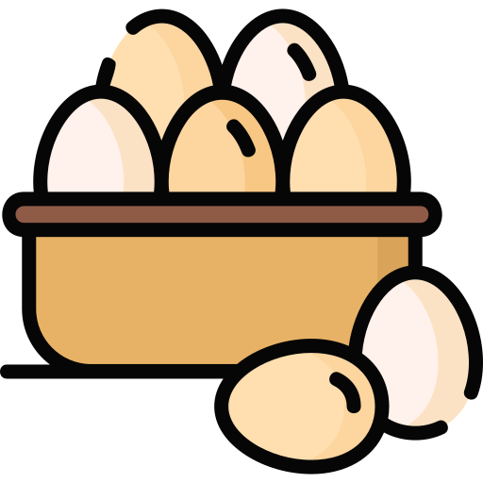
Artificial Intelligence with ML
Machine Learning: Un-Supervised & Semi-Supervised
Apriori Algorithm
Introduction to Apriori Algorithm
What is Frequent Itemset?
Item set
Minimum Support=3
Data set
Occurrence frequency =3
Frequent Item sets
Notes:
Frequent itemsets refer to those items whose support exceeds a threshold value or a minimum support specified by the user. This implies that if A and B form a frequent itemset together, then A and B should also be frequent itemsets individually.
Consider the following two transactions: A= {1,2,3,4,5}, and B= {2,3,7}, In these transactions, 2 and 3 are identified as the frequent itemsets.

Slide 86

SOLVED EXAMPLE to UNDERSTAND THE STEPS

Slide 87


Slide 88


Slide 89


Slide 90


Slide 91


Slide 92

ASSOCIATION RULE MINING-SUBSET CREATION
Lets say S is milk then Milk (Milk,bread,butter-milk)

Slide 93


ASSOCIATION RULE MINING-SUBSET CREATION

Slide 94


ASSOCIATION RULE MINING-SUBSET CREATION
valid

Slide 95


valid

Slide 96
Artificial Intelligence with ML
Machine Learning: Un-Supervised & Semi-Supervised
Apriori Algorithm
Introduction to Apriori Algorithm
Candidate Generation in Apriori Algorithm
Candidate generation is a key step in the Apriori algorithm where new potential frequent itemsets (candidates) are generated from the frequent itemsets identified in the previous iteration.
Initial Frequent Itemsets
Joining Step
Candidates for Next Iteration
Notes:
Initial Frequent Itemsets: Begin with all single items that meet the minimum support threshold
Joining Step: Combine these frequent itemsets to generate larger candidate itemsets (e.g., combining frequent pairs to form candidate triplets).
Candidates for Next Iteration: These generated candidate itemsets are then tested for support in the dataset.

Slide 97
Artificial Intelligence with ML
Machine Learning: Un-Supervised & Semi-Supervised
Apriori Algorithm
Introduction to Apriori Algorithm
Pruning in Apriori Algorithm
Pruning is the process of eliminating candidate itemsets that are not frequent, ensuring the algorithm remains efficient by reducing the number of candidates to consider in subsequent iterations.
Eliminate Infrequent Itemsets
Apply Minimum Support
Reduce Search Space
Notes:
Eliminate Infrequent Itemsets: After generating candidate itemsets, count their occurrences in the dataset.
Apply Minimum Support: Discard candidates that do not meet the minimum support threshold.
Reduce Search Space: This step significantly reduces the search space by removing itemsets that cannot possibly be frequent.

Slide 98
Artificial Intelligence with ML
Machine Learning: Un-Supervised & Semi-Supervised
Apriori Algorithm
Introduction to Apriori Algorithm
Apriori Algorithm steps
Initialization:
Start with a minimum support threshold.
Generate the candidate itemsets of size one.
Itemset Generation:
Generate candidate itemsets of size 𝑘 from frequent itemsets of size 𝑘 −1.

Slide 99
Artificial Intelligence with ML
Machine Learning: Un-Supervised & Semi-Supervised
Apriori Algorithm
Introduction to Apriori Algorithm
Apriori Algorithm steps
Prune Non-Frequent Itemsets:
Scan the transaction database to determine the support of each candidate itemset.
Discard itemsets that do not meet the minimum support threshold.
Repeat:
Repeat steps 2 and 3 until no more candidate itemsets can be generated.

Slide 100
Artificial Intelligence with ML
Machine Learning: Un-Supervised & Semi-Supervised
Apriori Algorithm
Introduction to Apriori Algorithm
Apriori Algorithm steps
Generate Association Rules:
For each frequent itemset, generate all non-empty subsets.
For every non-empty subset 𝑆 of itemset 𝐼, calculate the confidence of the rule 𝑆→(𝐼−𝑆).
Retain the rules that meet the minimum confidence threshold.
Output:
The result is the set of all association rules that meet the specified minimum support and confidence thresholds.

Slide 101
Artificial Intelligence with ML
Machine Learning: Un-Supervised & Semi-Supervised
Minimum Support= 50%
C1
L1
Database DB
TID | Items
A | a b c
B | c d e
C | a b
D | a b c e
itemset | sup
{a} | 3
{b} | 3
{c} | 3
{d} | 1
{e} | 2
itemset | sup
{a} | 3
{b} | 3
{c} | 3
{e} | 2
C2
itemset
{a b}
{a c}
{a e}
{b c}
{b e}
{c e}
C2
itemset | sup
{a b} | 3
{a c} | 2
{a e} | 1
{b c} | 2
{b e} | 1
{c e} | 2
Scan DB
Scan DB
L2
itemset | sup
{a b} | 3
{a c} | 2
{b c} | 2
{c e} | 2
L3
C3
C3
itemset | sup
{a b c} | 2
itemset | sup
{a b c} | 2
{a b e} | 1
itemset
{a b c}
{a b e}
Scan DB
Notes:
Step-1: Evaluate the support of itemsets in the transactional database, and choose the minimum support and confidence levels.
Step-2: Consider all supports in the transaction that have a support value greater than the minimum or chosen support value.
Step-3: Identify all the rules within these subsets that have a confidence value higher than the threshold or minimum confidence.
Step-4: Arrange the rules in descending order based on lift.

Slide 102
Artificial Intelligence with ML
Machine Learning: Un-Supervised & Semi-Supervised
Apriori Algorithm
Advantages and limitations of the algorithm
Advantages | Limitations
Simple Implementation | Relies on the Apriori property
Efficient | Require significant memory
Scalable | Computationally expensive Candidate Generation
Support for Thresholds | Threshold setting is challenging
Widely Adopted | Limited to Single-Level Searches
Notes:
Simple Implementation:The Apriori algorithm is straightforward to understand and implement, making it accessible to users with varying levels of expertise.
Efficiency: It employs a breadth-first search strategy combined with pruning techniques to efficiently generate frequent itemsets, reducing the search space and computational complexity.
Scalability: The Apriori algorithm is scalable and can handle large datasets efficiently, making it suitable for mining association rules from big data.
Support for Thresholds: Users can set minimum support and confidence thresholds to control the quality and relevance of the discovered association rules.
Widely Adopted: It is one of the most widely used algorithms for association rule mining and has been extensively studied and implemented in various data mining tools and libraries.
Apriori Property: The algorithm relies on the Apriori property, which states that if an itemset is frequent, then all of its subsets must also be frequent. This can lead to a large number of candidate itemsets, especially for datasets with high dimensionality.
Memory Usage: The Apriori algorithm may require significant memory to store candidate itemsets and transaction databases, particularly for large datasets.
Candidate Generation: Generating candidate itemsets can be computationally expensive, especially for datasets with many items or low support thresholds.
Static Thresholds: Setting appropriate support and confidence thresholds can be challenging and may require trial and error, leading to suboptimal results.
Limited to Single-Level Searches: Apriori performs single-level searches, which means it may miss interesting association rules that span multiple levels of abstraction in the dataset.

Slide 103
Artificial Intelligence with ML
Machine Learning: Un-Supervised & Semi-Supervised
Apriori Algorithm
Lab: Implement Apriori algorithm on ABC dataset
Problem Statement:
A grocery store chain wants to optimize its product placement, cross-selling strategies, and promotional campaigns by understanding the purchasing behavior of its customers. By implementing Apriori algorithm perform market basket analysis to identify which products are frequently bought together and use this information to increase sales and improve customer satisfaction.
Objective:
To perform market basket analysis using Apriori algorithm to gain insights into the purchasing behavior of customers at a grocery store chain using “Market_Basket_Optimisation.csv” dataset
Notes:
Dataset: https://www.kaggle.com/datasets/heeraldedhia/groceries-dataset

Slide 104
Artificial Intelligence with ML
Machine Learning: Un-Supervised & Semi-Supervised
Apriori Algorithm
Lab: Implement Apriori algorithm on ABC dataset
Steps:
Data Collection and Exploration
Load the dataset and identify the key features and target variable.
Data Preprocessing
Clean and prepare the data for modeling.
Handle missing values
Encode categorical variables
Normalize numerical features

Slide 105
Artificial Intelligence with ML
Machine Learning: Un-Supervised & Semi-Supervised
Apriori Algorithm
Lab: Implement Apriori algorithm on ABC dataset
Steps:
Frequent Itemset Mining:
Use the Apriori algorithm to identify frequent itemsets in the transaction data.
from mlxtend.frequent_patterns import apriori
apriori(df,min_support=0.5,use_colnames=False, max_len=None, verbose=0, low_memory=False)
Association Rule Mining:
Generate association rules from the frequent itemsets to uncover product associations.
from mlxtend.frequent_patterns import association_rules
association_rules(freq_items, metric="confidence", min_threshold=0.001)

Slide 106
Artificial Intelligence with ML
Machine Learning: Un-Supervised & Semi-Supervised
Apriori Algorithm
Lab: Implement Apriori algorithm on ABC dataset
Steps:
Insights and Recommendations
Analyze the generated rules to derive insights and make recommendations.

Slide 107
Artificial Intelligence with ML
Machine Learning: Un-Supervised & Semi-Supervised
FP-Growth Algorithm
Introduction to FP-Growth Algorithm
FP-Growth (Frequent Pattern Growth) is an efficient algorithm for mining frequent itemsets without candidate generation.
It uses a compact data structure called the FP-tree (Frequent Pattern Tree) to represent the dataset.
Candidate generation is a key concept in association rule mining algorithms, particularly in Apriori, and refers to the process of generating possible itemsets (called candidates) that could potentially be frequent based on previous knowledge about the data. These candidate itemsets are then checked (or counted) to see if they meet the minimum support threshold, which is the fraction of transactions in the dataset that contain the itemset.

Slide 108


FREQUENT PATTERN GROWTH
SOLVED EXAMPLE

Slide 109


Slide 110



Slide 111


Slide 112



Slide 113



Slide 114


Slide 115



Slide 116


Slide 117


Slide 118


Slide 119


Slide 120
K Y Y K we will find confidence of both whoever is having confidence greater than threshold,we will create that association rule
Now we will find association rules like for 1st one it will be either

Slide 121
Artificial Intelligence with ML
Machine Learning: Un-Supervised & Semi-Supervised
FP-Growth Algorithm
Introduction to FP-Growth Algorithm
Process:
Construct the FP-tree: A compact representation of the dataset where only frequent items are included
Mine the FP-tree: Extract frequent itemsets directly from the FP-tree without generating candidate itemsets.

Slide 122
Artificial Intelligence with ML
Machine Learning: Un-Supervised & Semi-Supervised
FP-Growth Algorithm
Introduction to FP-Growth Algorithm
FP-Growth Algorithm steps
Build the FP-tree:
Scan the dataset to determine the frequency of each item.
Sort items by frequency and discard infrequent items.
Construct the FP-tree by inserting transactions in a sorted order
Mine the FP-tree:
Starting from the root, recursively mine the tree to extract frequent itemsets.
Use a divide-and-conquer strategy to decompose the mining task into smaller tasks.

Slide 123
Artificial Intelligence with ML
Machine Learning: Un-Supervised & Semi-Supervised
Minimum Support= 50%
Frequent Pattern set
Database DB
TID | Items | Ordered Items set
A | a b c e | a b c
B | c d | c
C | a b | a b
D | a c | a c
L
itemset | sup
{a} | 3
{b} | 3
{c} | 2
Database DB
TID | Items
A | a b c e
B | c d
C | a b
D | a c
itemset | sup
{a} | 3
{b} | 3
{c} | 2
{d} | 1
{e} | 1
Scan DB
Null
Null
Null
Null
a=1
a=1
a=2
a=2
b=1
b=1
b=2
b=2
c=1
c=1
c=1
c=1
c=1
c=1
c=1
c=1
Notes:
"Consider a database DB. The frequency of each individual item is calculated, and let’s assume the minimum support is 2. A Frequent Pattern set is constructed, which includes all elements with a frequency equal to or greater than the minimum support. These elements are arranged in descending order based on their frequencies. After the relevant items are inserted, the set L is displayed.
Next, for each transaction, the corresponding Ordered-Item set is created. This is done by iterating through the Frequent Pattern set and verifying if the current item is present in the transaction under consideration. If the current item is present, it is added to the Ordered-Item set for that transaction. All the Ordered-Item sets are then incorporated into a Tree Data Structure.

Slide 124
Artificial Intelligence with ML
Machine Learning: Un-Supervised & Semi-Supervised
FP-Growth Algorithm
Introduction to FP-Growth Algorithm
FP-Growth Algorithm steps
Items | Conditional Pattern Base
c | {{a b:1},{a:1}
b | {{a:2}}
a
Items | Conditional Pattern Base | Conditional Frequent Pattern Tree
c | {{a b:1},{a:1} | {a:2}
b | {{a:2}} | {a:2}
a
Notes:
For each item, we calculate what’s known as the Conditional Pattern Base. This is made up of path labels from all paths that lead to any node of the specified item in the frequent-pattern tree. It’s worth noting that the items in the subsequent table are organized in ascending order by their frequencies.
Following this, we construct the Conditional Frequent Pattern Tree for each item. This is done by identifying the set of elements that appear in all paths in the Conditional Pattern Base of that item. The support count is then determined by summing the support counts of all paths in the Conditional Pattern Base.

Slide 125

Artificial Intelligence with ML
Machine Learning: Un-Supervised & Semi-Supervised
FP-Growth Algorithm
Introduction to FP-Growth Algorithm
FP-Growth Algorithm steps
For each row, two types of association rules can be inferred for example for the first row which contains the element, the rules a$→$ c and c $→$ a can be inferred.
Items | Frequent Pattern Generated
c | {<a c:2>}
b | {<a b:2>}
a
Notes:
From the Conditional Frequent Pattern tree, the Frequent Pattern rules are formulated by associating the items of the Conditional Frequent Pattern Tree set with the corresponding item as indicated in the table.
To identify the valid rule, the confidence of both rules is computed. The rule with a confidence equal to or higher than the minimum confidence value is kept.

Slide 126
Artificial Intelligence with ML
Machine Learning: Un-Supervised & Semi-Supervised
FP-Growth Algorithm
Advantages and limitations of the algorithm
Advantages | Limitations
Efficient in handling large datasets | Can be complex to implement
Reduces the size of the candidate sets | Requires a two-phase process
Uses a divide-and-conquer approach | Memory-intensive due to FP-tree storage
Avoids candidate generation and testing | Performance can degrade with highly dynamic data
Can handle large datasets with frequent patterns | Difficult to update FP-tree incrementally
Scalable to larger datasets | Requires enough memory to store FP-tree
Finds complete set of patterns | Complex tree traversal can be time-consuming
Works well with both sparse and dense data | Less intuitive for understanding the underlying process
No need for multiple database scans | Cannot directly handle continuous data without preprocessing

Slide 127
Artificial Intelligence with ML
Machine Learning: Un-Supervised & Semi-Supervised
FP-Growth Algorithm
Lab: Implement FP-Growth Algorithm on ABC dataset
Steps:
Data Collection and Exploration
Load the dataset and identify the key features and target variable.
Data Preprocessing
Clean and prepare the data for modeling.
Handle missing values
Encode categorical variables
Normalize numerical features

Slide 128
Artificial Intelligence with ML
Machine Learning: Un-Supervised & Semi-Supervised
FP-Growth Algorithm
Lab: Implement FP-Growth Algorithm on ABC dataset
Steps:
Frequent Itemset Mining:
Use the FP-Growth algorithm to identify frequent itemsets in the transaction data.
from mlxtend.frequent_patterns import fpgrowth
fpgrowth(df, min_support=0.6)
Association Rule Mining:
Generate association rules from the frequent itemsets to uncover product associations.
from mlxtend.frequent_patterns import association_rules
association_rules(freq_items, metric="confidence", min_threshold=0.001)

Slide 129
Artificial Intelligence with ML
Machine Learning: Un-Supervised & Semi-Supervised
FP-Growth Algorithm
Lab: Implement FP-Growth Algorithm on ABC dataset
Steps:
Insights and Recommendations
Analyze the generated rules to derive insights and make recommendations.

Slide 130

Artificial Intelligence with ML
Machine Learning: Un-Supervised & Semi-Supervised
Evaluation Metrics for Association Rule Mining
Overview of evaluation metrics
Evaluation metrics for unsupervised learning differ from those used in supervised learning because unsupervised learning does not rely on labeled data.
Silhouette Score
Measures how similar an object is to its own cluster compared to other clusters.
Ranges from -1 (incorrect clustering) to +1 (highly dense clustering).
Formula:
Silhouette $Score=\frac{b(i)−a(i)}{max⁡(a(i),b(i))}$
𝑎(𝑖): average intra-cluster distance for point 𝑖.
𝑏(𝑖): average nearest-cluster distance for point 𝑖.

Slide 131

Artificial Intelligence with ML
Machine Learning: Un-Supervised & Semi-Supervised
Evaluation Metrics for Association Rule Mining
Overview of evaluation metrics
Davies-Bouldin Index
Evaluates clustering by computing the average similarity ratio of each cluster with its most similar cluster.
Lower values indicate better clustering.
Formula:
$$DBI=\frac{1}{n}\sum_{i=1}^{n}{\max_{j≠i}(\frac{s_{i}+s_{j}}{d_{ij}})}$$
$s_{i}$: average distance of cluster 𝑖 to its centroid.
$d_{ij}$: distance between centroids of clusters 𝑖and 𝑗.

Slide 132

Artificial Intelligence with ML
Machine Learning: Un-Supervised & Semi-Supervised
Evaluation Metrics for Association Rule Mining
Overview of evaluation metrics
Calinski-Harabasz Index (Variance Ratio Criterion)
Measures the ratio of the sum of between-cluster dispersion to within-cluster dispersion.
Higher values indicate better-defined clusters.
Formula:
$$CH Index=\frac{trace(Bk)}{trace(Wk)}⋅\frac{N−k}{k−1}$$
𝐵𝑘 : between-cluster dispersion matrix.
𝑊𝑘: within-cluster dispersion matrix.
𝑁: number of samples.
𝑘: number of clusters.

Slide 133

Artificial Intelligence with ML
Machine Learning: Un-Supervised & Semi-Supervised
Evaluation Metrics for Association Rule Mining
Overview of evaluation metrics
Dunn Index
Measures the ratio of the smallest distance between observations in different clusters to the largest intra-cluster distance.
Higher values indicate better clustering.
Formula:

Slide 134
Artificial Intelligence with ML
Machine Learning: Un-Supervised & Semi-Supervised
Evaluation Metrics for Association Rule Mining
Importance of evaluation metrics
1
Assessing Algorithm Performance
Improving Model Robustness
4
Quantitative evaluation
Benchmarking
Error identification
Model validation
2
Model Selection
Guiding Model Development
5
Optimal parameter tuning
Choosing the right algorithm
Development feedback
Iterative improvement
3
Understanding Data Structure
Interpretability and Explainability
6
Insight into data
Data quality
Clarity on model output
Communicating results
Notes:
Quantitative Evaluation: Metrics provide a way to quantitatively evaluate the performance of unsupervised learning algorithms, allowing for objective comparison between different methods or configurations.
Benchmarking: They serve as benchmarks to determine how well the algorithm performs relative to others or to a baseline method.
Optimal Parameter Tuning: Evaluation metrics help in selecting the best parameters for the algorithm, such as the number of clusters in clustering algorithms.
Choosing the Right Algorithm: They aid in choosing the most suitable algorithm for a given dataset and task by comparing different algorithms' performance.
Insight into Data: Metrics can provide insights into the underlying structure and patterns within the data, such as identifying the natural grouping or dimensionality.
Data Quality: They can also indicate the quality of the data, for instance, if the data forms well-defined clusters or if it is noisy and difficult to group.
Error Identification: Evaluation metrics help in identifying errors or weaknesses in the model, such as overfitting or poor generalization.Model Validation: They are essential for validating the model to ensure it is capturing the meaningful structure in the data rather than noise.
Development Feedback: Metrics provide feedback during the development phase, guiding researchers and practitioners in refining their models.Iterative Improvement: They support an iterative approach to model building, where the model is continuously improved based on evaluation outcomes.
Clarity on Model Output: Metrics help in interpreting the results of unsupervised learning algorithms, making it easier to understand the model’s output and behavior.
Communicating Results: They are useful for communicating the effectiveness and results of the model to stakeholders, providing clear evidence of the model's performance.

Slide 135
Artificial Intelligence with ML
Machine Learning: Un-Supervised & Semi-Supervised
Real-world examples
Application Area | Example | Description
Customer Segmentation | Retail and E-commerce | Segmenting customers based on purchasing behavior for targeted marketing and personalized recommendations.
Anomaly Detection | Fraud Detection | Identifying unusual transactions that could indicate fraud.
 | Network Security | Detecting unusual patterns in network traffic for security breaches.
Recommendation Systems | Content-Based Recommendations | Recommending products or content based on user behavior and content features.
Market Basket Analysis | Retail | Discovering items frequently bought together for product placement and cross-selling.
Document Clustering | News Aggregation | Grouping articles into topics for better navigation.
 | Search Engines | Improving search accuracy by clustering similar documents.
Image and Video Analysis | Image Segmentation | Dividing images into segments for easier analysis.
 | Object Detection | Identifying and categorizing objects within images.

Slide 136
Artificial Intelligence with ML
Machine Learning: Un-Supervised & Semi-Supervised
Real-world examples
Application Area | Example | Description
Genomic Data Analysis | Gene Expression Analysis | Clustering genes with similar expression patterns to understand functions and regulations.
 | Disease Subtyping | Identifying disease subtypes based on genetic information.
Social Network Analysis | Community Detection | Finding groups within social networks to understand structures and influence.
 | Content Filtering | Categorizing content to moderate online communities and detect spam.
Natural Language Processing | Text Clustering | Grouping similar texts for summarization or trend analysis.
 | Word Embeddings | Learning vector representations of words for various NLP tasks.
Customer Experience | Chatbots and Virtual Assistants | Improving response accuracy by clustering similar user queries.
 | Sentiment Analysis | Clustering feedback to identify common issues and improvement areas.
Healthcare and Medical | Patient Segmentation | Grouping patients with similar medical histories for personalized treatment.

Slide 137
Artificial Intelligence with ML
Machine Learning: Un-Supervised & Semi-Supervised
Introduction to Semi-Supervised Learning
Definition and purpose of Semi-Supervised Learning
Semi-Supervised Learning combines both labeled and unlabeled data to train models.
It lies between supervised learning (using only labeled data) and unsupervised learning (using only unlabeled data).
Goal: Enhance learning accuracy by leveraging large amounts of unlabeled data along with a small amount of labeled data.

Slide 138
Artificial Intelligence with ML
Machine Learning: Un-Supervised & Semi-Supervised
Introduction to Semi-Supervised Learning
Purpose of Semi-Supervised Learning
Improving Model Performance
Enhances the accuracy and robustness of models by using more data.
Useful when labeled data is limited.
Reducing Labeling Costs
Decreases the need for extensive labeled datasets.
Saves time and resources as labeling data is expensive and labor-intensive.

Slide 139
Artificial Intelligence with ML
Machine Learning: Un-Supervised & Semi-Supervised
Introduction to Semi-Supervised Learning
Advantages of Semi-Supervised Learning
Cost-Effective: Reduces the need for extensive labeled data, saving costs.
Efficiency: Utilizes the abundance of unlabeled data effectively.
Performance: Often leads to better model performance compared to using only labeled data.

Slide 140
Artificial Intelligence with ML
Machine Learning: Un-Supervised & Semi-Supervised
Introduction to Semi-Supervised Learning
Disadvantages of Semi-Supervised Learning
Model Complexity
Semi-supervised learning models can be more complex to design and implement.
Quality of Unlabeled Data
Success heavily relies on the quality and relevance of unlabeled data.
Computational Resources
Requires increased computational resources due to processing large amounts of data.

Slide 141
Artificial Intelligence with ML
Machine Learning: Un-Supervised & Semi-Supervised
Introduction to Semi-Supervised Learning
Disadvantages of Semi-Supervised Learning
Complex Training Process
Training process can be intricate and time-consuming.
Risk of Overfitting
There's a risk of overfitting to patterns in the unlabeled data.
Applicability Constraints
Not suitable for all problems; effectiveness depends on the availability and relevance of unlabeled data.

Slide 142
Artificial Intelligence with ML
Machine Learning: Un-Supervised & Semi-Supervised
Introduction to Semi-Supervised Learning
Comparison with Supervised Learning
Aspect | Supervised Learning | Semi-Supervised Learning
Definition | Model trained on a fully labeled dataset | Model trained using both labeled and unlabeled data
Data Requirements | Requires a large amount of labeled data | Requires a small amount of labeled data and a large amount of unlabeled data
Labeling Cost | High, as all data points need to be labeled | Lower, since only a small portion of the data needs to be labeled
Learning Process | Direct learning from labeled data | Combines labeled data for direct learning and unlabeled data for improving the model’s generalization
Performance | High performance if enough labeled data is available | Can achieve high performance even with limited labeled data

Slide 143
Artificial Intelligence with ML
Machine Learning: Un-Supervised & Semi-Supervised
Introduction to Semi-Supervised Learning
Comparison with Supervised Learning
Aspect | Supervised Learning | Semi-Supervised Learning
Use Cases | Image classification, sentiment analysis, regression tasks | Natural language processing, image recognition with limited labels, medical diagnosis with few annotated samples
Handling Uncertainty | Relies solely on labeled data, which may not capture all variance | Uses unlabeled data to better capture underlying data distribution and reduce uncertainty
Examples of Algorithms | Decision trees, support vector machines, neural networks | Self-training, co-training, graph-based methods, semi-supervised GANs
Data Utilization | Utilizes only labeled data for training | Utilizes both labeled and unlabeled data, enhancing learning efficiency
Training Complexity | Generally straightforward but requires large labeled datasets | More complex due to the integration of unlabeled data

Slide 144
Artificial Intelligence with ML
Machine Learning: Un-Supervised & Semi-Supervised
Introduction to Semi-Supervised Learning
Comparison with Unsupervised Learning
Aspect | Unsupervised Learning | Semi-Supervised Learning
Definition | Model trained on a dataset with no labels | Model trained using a combination of labeled and unlabeled data
Data Requirements | Requires only unlabeled data | Requires a small amount of labeled data and a large amount of unlabeled data
Labeling Cost | None, as no labels are needed | Lower, since only a small portion of the data needs to be labeled
Learning Process | Discovers hidden patterns or intrinsic structures in input data | Combines labeled data for direct learning and unlabeled data for improving the model’s generalization
Performance | Can identify structure and relationships but not specific labels | Can achieve high performance by leveraging labeled data for direct supervision and unlabeled data for auxiliary learning

Slide 145
Artificial Intelligence with ML
Machine Learning: Un-Supervised & Semi-Supervised
Introduction to Semi-Supervised Learning
Comparison with Unsupervised Learning
Aspect | Unsupervised Learning | Semi-Supervised Learning
Use Cases | Clustering, anomaly detection, dimensionality reduction | Natural language processing, image recognition with limited labels, medical diagnosis with few annotated samples
Handling Uncertainty | Focuses on finding structure without any explicit labels | Uses unlabeled data to better capture underlying data distribution and reduce uncertainty, while labeled data guides learning
Examples of Algorithms | K-means, hierarchical clustering, principal component analysis (PCA) | Self-training, co-training, graph-based methods, semi-supervised GANs
Data Utilization | Utilizes only unlabeled data | Utilizes both labeled and unlabeled data, enhancing learning efficiency
Training Complexity | Generally straightforward but can be computationally intensive | More complex due to the integration of both labeled and unlabeled data

Slide 146
Artificial Intelligence with ML
Machine Learning: Un-Supervised & Semi-Supervised
Introduction to Semi-Supervised Learning
Applications of Semi-Supervised Learning
1
Natural Language Processing (NLP)
Speech and Audio Processing
4
Speech Recognition
Speaker Identification
Text Classification
Machine Translation
Named Entity Recognition (NER
2
Computer Vision
5
Bioinformatics
Image Classification
Object Detection
Image Segmentation
Gene Function Prediction
Protein Structure Prediction
3
Medical Imaging
Finance
6
Disease Diagnosis
Tumor Detection
Fraud Detection
Risk Assessment
Notes:
Text Classification: Enhancing the performance of models for sentiment analysis, spam detection, and topic categorization with limited labeled texts. Machine Translation: Improving translation systems by utilizing a small amount of labeled bilingual text and large amounts of monolingual text. Named Entity Recognition (NER): Identifying entities in text using limited annotated examples supplemented with unlabeled data.
Image Classification: Classifying images into categories when only a few labeled images are available. Object Detection: Detecting and localizing objects within images using minimal labeled data. Image Segmentation: Dividing an image into meaningful parts using a combination of labeled and unlabeled images.
Medical Imaging
Disease Diagnosis: Identifying diseases in medical images such as X-rays, MRIs, and CT scans with limited annotated data.
Tumor Detection: Detecting tumors in medical images where labeled samples are scarce but a large amount of unlabeled data is available.
Speech Recognition: Improving speech-to-text systems by combining a small set of transcribed audio with a large corpus of untranscribed audio.Speaker Identification: Identifying speakers using limited labeled voice samples and additional unlabeled data.
Gene Function Prediction: Predicting the functions of genes using a mix of labeled gene functions and large sets of unlabeled genomic data.Protein Structure Prediction: Leveraging a combination of labeled protein structures and unlabeled protein sequences to predict protein folding and functions.
Fraud Detection: Identifying fraudulent transactions with a small set of labeled fraudulent examples supplemented with a large amount of unlabeled transaction data.Risk Assessment: Assessing financial risks by utilizing limited labeled data and a larger set of unlabeled financial records.

Slide 147
Artificial Intelligence with ML
Machine Learning: Un-Supervised & Semi-Supervised
Introduction to Semi-Supervised Learning
Types of Semi-Supervised Learning
Self-training
1
Train initial model on labeled data
Predict labels for unlabeled data
Add confident predictions to labeled data
Repeat iteratively
Graph-Based Methods
3
Represent data as a
Propagate labels through the graph
Includes methods like Label Propagation and Graph Convolutional Networks
Co-Training
2
Requires two different views of data
Train separate classifiers on each view
Classifiers label unlabeled data for each other
Retrain iteratively with shared predictions

Slide 148
Artificial Intelligence with ML
Machine Learning: Un-Supervised & Semi-Supervised
Self Training
Self-Training Algorithm
Labelling 1
training 1
Model
training 2
Labeled and Unlabeled data
Labelling 2
Labeled Data
Notes:
The initial training phase involves a labeled dataset comprising four samples, distinguished by two different labels. Following this, the model undergoes training using this dataset. Subsequently, a combination of labeled and unlabeled data is introduced to the model, prompting it to assign labels to previously unlabeled instances. This augmented dataset, inclusive of newly labeled data points, is then utilized for subsequent model training iterations. This iterative process persists until all data points are appropriately labeled.

Slide 149
Artificial Intelligence with ML
Machine Learning: Un-Supervised & Semi-Supervised
Self Training
Self-Training Algorithm
Initial Training
Train model on labeled data
Prediction on Unlabeled Data
Model predicts labels for unlabeled data
Confidence Filtering
Select most confident predictions
Expand Labeled Data
Add confident predictions to labeled dataset
Iterative Retraining
Retrain model with expanded labeled data
Repeat process
Notes:
SME NOTES:
Points can be represented in two sections rather than one single list. (3 and 3 on left and right sides)

Slide 150
Artificial Intelligence with ML
Machine Learning: Un-Supervised & Semi-Supervised
Self Training
Self-training with confidence threshold
Semi-supervised learning utilizes both labeled and unlabeled data.
Self-training with confidence threshold enhances basic self-training.
It ensures the reliability of predictions added to the labeled dataset.

Slide 151
Artificial Intelligence with ML
Machine Learning: Un-Supervised & Semi-Supervised
Self Training
Self-training with confidence threshold
Initial Training
Retrained Model
(Predict labels)
Confidence filtering
Add to labeled data
Repeat until convergence
Unlabeled data
(Du)
Final model
Labeled data
(Dl)
Model prediction
on Unlabeled data (Du)
Add to labeled data
Retrain model
Confidence filtering
Notes:
Input Data
Labeled Data (D_l)
Unlabeled Data (D_u)
2. Initial Training
Model Training: Train initial model on labeled data (D_l)
3. Prediction
Predict Labels: Use the trained model to predict labels for unlabeled data (D_u)
4. Confidence Filtering
Select Confident Predictions: Filter predictions based on confidence threshold
5. Expand Labeled Data
Add to Labeled Set: Add confident predictions to labeled data (D_l)
6. Iterative Retraining
Retrain Model: Retrain the model with the expanded labeled data
Repeat Process: Repeat steps 3 to 6 until convergence or stopping criteria are met
7. Final Model
Output: The final trained model after iterative retraining

Slide 152
Artificial Intelligence with ML
Machine Learning: Un-Supervised & Semi-Supervised
Self Training
Label Spreading Algorithm
Definition: Label Spreading is a semi-supervised learning algorithm.
Objective: Propagates labels through a dataset using a graph-based method.
Usage: Effective when labeled data is scarce and unlabeled data is abundant.
Propagation Rule: The label spreading algorithm, uses a regularization framework that smooths the labels over the graph.

Slide 153
Artificial Intelligence with ML
Machine Learning: Un-Supervised & Semi-Supervised
Self Training
Label Propagation Algorithm
Propagation Rule: The label propagation algorithm updates the labels of nodes based on their neighbors' labels without considering any form of regularization.
Update Formula: The labels are updated using a simple rule that relies solely on the neighboring nodes. Typically, it involves taking a weighted average of the labels of the neighboring nodes.
Regularization: Does not explicitly regularize the label distribution. It purely depends on the iterative propagation process. Convergence: May lead to label oscillation or instability because of the lack of regularization.
Notes:
SME-NOTES: Can add Comparison of Label Propagation and Label Spreading Algorithm in Next Slide.

Slide 154
Artificial Intelligence with ML
Machine Learning: Un-Supervised & Semi-Supervised
Self Training
Label Propagation Algorithm
7
7
7
9
9
9
6
10
6
10
6
10
1
4
1
4
1
4
2
5
2
5
2
5
3
3
3
8
8
8
Iterations
Notes:
Graph Generation: Create a graph comprising nodes and edges, with weights assigned to edges according to node similarity.
Initial Labeling: Assign starting labels to nodes that are already labeled and initialize labels for those that are not.
Label Propagation: Continue iterating until convergence or after a set number of iterations: For each unlabeled node, adjust its label based on neighboring node labels. For labeled nodes, maintain their labels unchanged.
Convergence Verification: Verify if labels have stabilized or the maximum iteration limit has been reached.
Results: Provide the ultimate labels for all nodes.

Slide 155
Artificial Intelligence with ML
Machine Learning: Supervised
Self Training
Lab: Implement a self-training algorithm
Problem Statement :
An e-commerce platform similar to Amazon, is interested in understanding customer sentiments towards food products based on user reviews. Develop an accurate sentiment analysis system for food reviews using the Amazon Fine Food Review dataset using self-training algorithm.
Objective:
To develop precise sentiment analysis for food reviews using self-training algorithm.
Notes:
Dataset: https://www.kaggle.com/datasets/snap/amazon-fine-food-reviews

Slide 156
Artificial Intelligence with ML
Machine Learning: Supervised
Self Training
Lab: Implement a self-training algorithm
Steps:
Data Collection:
Gather comprehensive food review data for sentiment analysis purposes.
Data Preprocessing:
Cleanse, standardize, and prepare data for analysis accurately.
Feature Extraction:
Convert textual data into numerical representations for model input.
Model Selection:
Choose an appropriate algorithm for sentiment analysis accuracy.
Notes:
https://www.kaggle.com/datasets/snap/amazon-fine-food-reviews

Slide 157
Artificial Intelligence with ML
Machine Learning: Supervised
Self Training
Lab: Implement a self-training algorithm
Steps:
Model Training:
Train the selected model on labeled dataset effectively.
from sklearn.semi_supervised import SelfTrainingClassifier
st_pipeline = Pipeline([('vect',CountVectorizer(**vectorizer_params)), ('tfidf', TfidfTransformer()), 'clf’, SelfTrainingClassifier(SGDClassifier(**sdg_params), verbose=True)),])
Self-Training Algorithm:
Enhance model with iterative pseudo-labeled data integration for precision.
Model Evaluation:
Assess model performance rigorously using established evaluation metrics such as accuracy
Notes:
https://www.kaggle.com/datasets/snap/amazon-fine-food-reviews
SME NOTES:
Can also add a slide showing when and on what type of data, different Models under Self-training algorithm should be used.

Slide 158


Artificial Intelligence with ML
Machine Learning: Un-Supervised & Semi-Supervised
Co-Training
A method where two classifiers iteratively label and learn from unlabeled data.
Initially proposed by Blum and Mitchell (1998).
Utilizes two views of the data.
Two distinct and complementary sets of features (views).
Assumption: Each view is sufficient to train a good classifier.
Applications : Real-world scenarios like web page classification, image annotation, etc.
Initial Labeled Training Data($D_{L}$)
View 1
View 2
Classifier 1
Classifier 2
Pseudo labeled instance provided by classifier 2
Pseudo labeled instance provided by classifier 1
Unlabeled instances($D_{u}$)

Slide 159


Example

Slide 160




Slide 161




Slide 162
Artificial Intelligence with ML
Machine Learning: Un-Supervised & Semi-Supervised
Co-Training
Co-Training with Naive Bayes
Based on Bayes' theorem with an assumption of feature independence.
Types: Gaussian, Multinomial, Bernoulli.
Strengths: Simplicity, efficiency, effective with small datasets.

Slide 163
Artificial Intelligence with ML
Machine Learning: Un-Supervised & Semi-Supervised
Co-Training
Co-Training with Naive Bayes
Initial Training:
Train two Naive Bayes classifiers on different views of the labeled data.
Labeling Unlabeled Data:
Each classifier predicts labels for the unlabeled data.
Confidence Threshold:
Select the most confidently labeled examples from each classifier.
Self-Training:
Add these confidently labeled examples to the labeled dataset.
Iteration:
Repeat the process until a stopping criterion is met (e.g., number of iterations or convergence).

Slide 164
Artificial Intelligence with ML
Machine Learning: Un-Supervised & Semi-Supervised
Co-Training
Co-Training with Support Vector Machines (SVM)
A supervised learning model used for classification and regression tasks.
Key Idea: Finds the hyperplane that best separates data into classes.
Strengths: Effective in high-dimensional spaces, robust to overfitting (especially in high dimensions).

Slide 165
Artificial Intelligence with ML
Machine Learning: Un-Supervised & Semi-Supervised
Co-Training
Co-Training with Support Vector Machines (SVM)
Initial Training:
Train two SVM classifiers on different views of the labeled data.
Labeling Unlabeled Data:
Each classifier predicts labels for the unlabeled data.
Confidence Threshold:
Select the most confidently labeled examples from each classifier.
Self-Training: Add these confidently labeled examples to the labeled dataset.
Iteration:
Repeat the process until a stopping criterion is met (e.g., number of iterations or convergence).

Slide 166


Artificial Intelligence with ML
Machine Learning: Un-Supervised & Semi-Supervised
Co-Training
Multi-view Co-Training
Initial Labeled Training Data($D_{L}$)
View 1
View n
Classifier 1
. . . .
Classifier n
Pseudo labeled instance provided by classifier n
Pseudo labeled instance provided by classifier 1
Unlabeled instances($D_{u}$)
Notes:
In multiple view co-training, the data is represented in multiple views, where each view is a different subset of features that describe the same instance.
Each view should be sufficiently informative to train a good classifier independently.
Views are assumed to be conditionally independent given the class label.
Split the feature space into multiple distinct views (e.g., view1, view2, ..., viewN).
Train a separate classifier on each view using the labeled data.

Slide 167
Artificial Intelligence with ML
Machine Learning: Un-Supervised & Semi-Supervised
Co-Training
Multi-view Co-Training-Example
Text Classification
Consider a text classification task where the goal is to classify web pages into different categories.
Views:
View 1 (Text Content): Features extracted from the text on the web page (e.g., word frequencies, TF-IDF scores).
View 2 (Hyperlinks): Features based on the hyperlink structure (e.g., number of incoming and outgoing links, anchor text of links).

Slide 168
Artificial Intelligence with ML
Machine Learning: Un-Supervised & Semi-Supervised
Co-Training
Multi-view Co-Training-Example
Text Classification
Process: Train one classifier on the text content features.
Train another classifier on the hyperlink features.
Use each classifier to label the unlabeled data.
Select the most confident predictions and add them to the labeled dataset.
Iterate this process to improve the classifiers.
Notes:
SME-NOTES
Can add Comparison of different Co-Learning Algorithms in Next Slide.

Slide 169
Artificial Intelligence with ML
Machine Learning: Un-Supervised & Semi-Supervised
Co-Training
Lab: Implement a co-training algorithm
Problem Statement :
BioTech Solutions is a leading biomedical company dedicated to developing innovative solutions for diagnosing and treating various types of cancer. Develop an accurate text classification system for categorizing biomedical text data into three cancer types: thyroid cancer, colon cancer, and lung cancer using the co-training algorithm.
Objective:
To develop accurate text classification for thyroid, colon, lung cancer using the co-training algorithm.
Notes:
Dataset: https://www.kaggle.com/datasets/sunilthite/text-document-classification-dataset
SME NOTES: Consider the below Problem statement for Lab exercise : Develop a semi-supervised model using Co-training algorithm to classify the emails sent and received by the user (Spam or Ham)
Utilize both the text and text features as different views to improve the sentiment classification accuracy.
Dataset Link: https://www.kaggle.com/datasets/uciml/sms-spam-collection-dataset

Slide 170
Artificial Intelligence with ML
Machine Learning: Un-Supervised & Semi-Supervised
Co-Training
Lab: Implement a co-training algorithm
Steps:
Data Collection:
Gather diverse biomedical text data related to cancer types.
Preprocessing:
Clean, tokenize, and preprocess text data for feature extraction.
Feature Extraction:
Extract informative features from preprocessed biomedical text data.
Labeling:
Manually label a small subset of text data samples.
Notes:
https://www.kaggle.com/datasets/sunilthite/text-document-classification-dataset

Slide 171
Artificial Intelligence with ML
Machine Learning: Un-Supervised & Semi-Supervised
Co-Training
Lab: Implement a co-training algorithm
Steps:
Co-training Algorithm:
Train classifiers using labeled and unlabeled data iteratively.
from mvlearn.semi_supervised import CTClassifier
ctc = CTClassifier(estimator1, estimator2, random_state=1)
Iterative Training:
Iteratively update classifiers with newly labeled data instances.
Evaluation:
Assess model performance rigorously using established evaluation metrics such as accuracy
Notes:
https://www.kaggle.com/datasets/sunilthite/text-document-classification-dataset
estimator1:The classifier used on view 1.
estimator2:The classifier used on view 2.
SME NOTES:
Can also add a slide showing when and on what type of data, different Models under Co-training algorithm should be used.

Slide 172
Artificial Intelligence with ML
Machine Learning: Un-Supervised & Semi-Supervised
Graph-Based Methods
Introduction to Graph-Based Semi-Supervised Learning
Data represented as nodes in a graph, with edges indicating relationships.
Uses graph structure to propagate labels from labeled to unlabeled nodes.
Nodes and Edges:
Nodes represent data points (e.g., documents, images).
Edges represent similarities or relationships between data points.
Similarity Measures : Euclidean distance, cosine similarity, etc.
Graph Types : k-NN graphs, epsilon-neighborhood graphs, fully connected graphs.

Slide 173
Artificial Intelligence with ML
Machine Learning: Un-Supervised & Semi-Supervised
Graph-Based Methods
Label Propagation on Graphs
5
5
6
6
LP
4
4
7
1
7
1
2
2
3
3
Notes:
Initialize: Assign labels to labeled nodes.
Propagate: Spread labels to neighboring unlabeled nodes based on edge weights.
Iterate: Repeat propagation until convergence.
Similar nodes (connected by edges) should have similar labels.

Slide 174
Artificial Intelligence with ML
Machine Learning: Un-Supervised & Semi-Supervised
Graph-Based Methods
Application and challenges
Application
Social Network Analysis: Detecting communities, identifying influential nodes.
Recommendation Systems: Item recommendation based on user-item graphs.
Bioinformatics: Gene function prediction, disease gene identification.
Challenges
Scalability: Constructing and processing large graphs can be computationally expensive.
Graph Construction: Quality of the graph affects performance.
Hyperparameter Tuning: Requires careful tuning of parameters like edge weights.

Slide 175
Artificial Intelligence with ML
Machine Learning: Un-Supervised & Semi-Supervised
Graph-Based Methods
Lab: Implement label propagation algorithm on a graph
Problem statement:
A social media monitoring and analytics company seeks to harnessing the power of graph-based algorithms, specifically the label propagation algorithm, to identify and counteract fake news propagation within social networks. Build an advanced system that uses label propagation algorithm for real-time detection and mitigation of fake news on social networks.
Objective:
To develop real-time system using label propagation to counteract fake news on social networks.
Notes:
https://www.kaggle.com/datasets/jainpooja/fake-news-detection SME NOTES:
Consider the below Problem statement for Lab exercise : Develop a graph-based semi-supervised learning model to enhance product recommendation accuracy using the Amazon Product Reviews dataset. The goal is to leverage both labeled (review ratings) and unlabeled (review text and product metadata) data to predict user preferences for products based on their historical interactions and similarities with other users.
Dataset Link : https://www.kaggle.com/datasets/saurav9786/amazon-product-reviews

Slide 176
.
Artificial Intelligence with ML
Machine Learning: Supervised
Graph-Based Methods
Lab: Implement label propagation algorithm on a graph
Steps:
Data Collection:
Gather diverse social media data containing news articles/posts.
Graph Construction:
Represent social network as a graph with nodes and edges.
Initial labelling
Begin with manual labeling of genuine and fake sources.
Feature extraction
Extract key features from news articles/posts for analysis.
Notes:
SME NOTES:
Title for this and the remaining Slide needs to be changed from Supervised to Semi-Supervised.

Slide 177
.
Artificial Intelligence with ML
Machine Learning: Supervised
Graph-Based Methods
Lab: Implement label propagation algorithm on a graph
Steps:
Graph Preprocessing
Clean and filter graph data to enhance the accuracy
Label Propagation Algorithm
Implement label propagation for spreading information within the graph.
from sklearn import semi_supervised
lp = semi_supervised.LabelPropagation()
LabelPropagation(alpha=1, gamma=20, kernel='rbf', max_iter=30, n_neighbors=7, tol=0.001)
Thresholding:
Introduce threshold to control label propagation range.

Slide 178
.
Artificial Intelligence with ML
Machine Learning: Supervised
Graph-Based Methods
Lab: Implement label propagation algorithm on a graph
Steps:
Detection and Flagging:
Identify and flag clusters indicating potential fake news propagation.
Verification and Intervention:
Verify flagged content and intervene as necessary.
Evaluation:
Assess algorithm performance and intervention effectiveness.
Accuracy
Precision
F-1 Score
Notes:
SME NOTES:
Can also add a slide showing when and on what type of data, different Models under Graph-Based Methods should be used.
3D/Animated video can be shown for better understanding for all the Unsupervised and Semi-Supervised Algorithms.
Can add a slide for Knowledge Check/MCQ regarding all the algorithms

Slide 179



?
Artificial Intelligence with ML
Sensitivity: L&T EduTech and LTIMindtree Use only

Slide 180
Application Architecture & Deployment
Thank You !!!
Sensitivity: L&T EduTech and LTIMindtree Use only

